Slide 1
Covid Impact on Child and Adolescent Mental Health
Joan Daughton, MD
Ashley Harlow, PhD
Children’s Behavioral Health
December 8, 2021

Slide 2
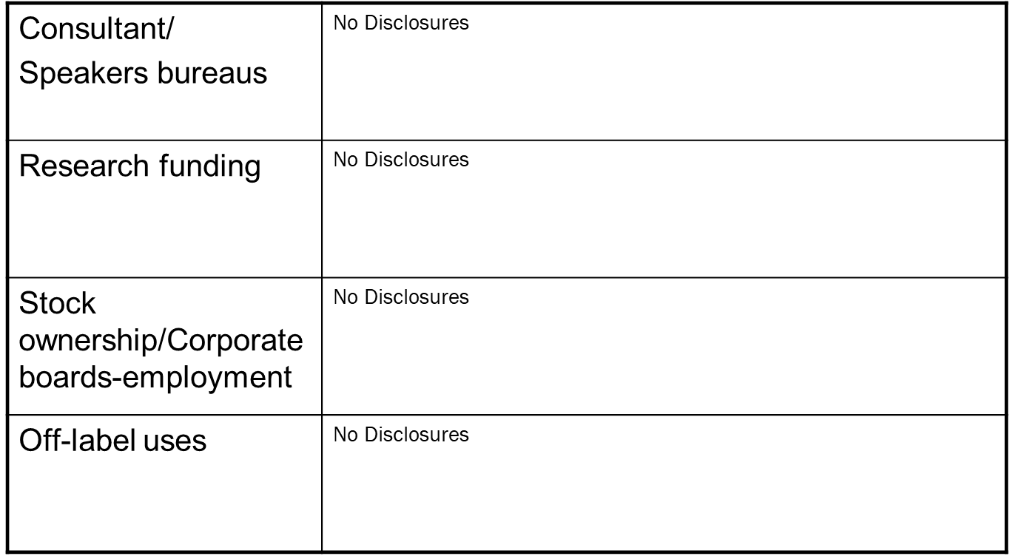
Disclosures?

Slide 3
Agenda
Review & Discuss MH Disparities
Summarize Effects of Pandemic on MH
Offer Interventions and Resources

Slide 4
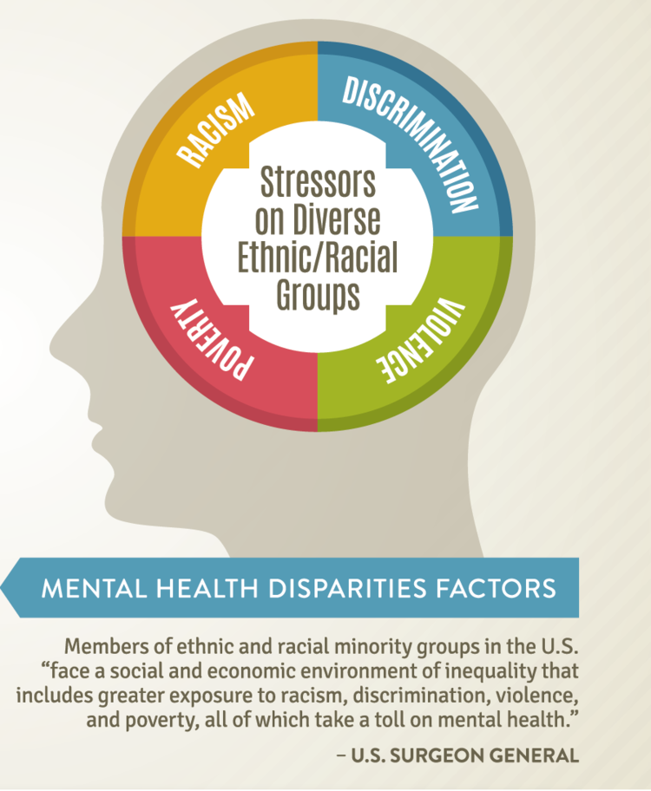
MH Disparities

Slide 5
Structural Racism – Baseline Risk
Chronic stress
BIPOC community in the US has more chronic health problems and shorter lifespans than whites at all income levels
Need fair hiring, fair lending practices, house and home ownership programs, anti-bias training, and community policing initiatives

Slide 6
Baseline Risk
Children living in households receiving SNAP benefits
40% of Black children
35% of American Indian/Alaska Native children
Two to three times more likely to receive SNAP benefits than white or Asian/Native Hawaiian and Other Pacific Islander children

Slide 7
Baseline Risk
Libraries and schools shut down – digital divide widens
Children lacking computers or paid high-speed internet access at home
Half of all American Indian/Alaska Native children
More than one-third of Black and Latinx children
1/5 of non-Hispanic white children
1 in 7 Asian/Native Hawaiian and other pacific islander

Slide 8
US Indigenous Population – Baseline Risk
Limited access to healthcare, overcrowded and multigenerational housing, high rates of poverty and chronic disease, limited access to clean water and grocery stores
Traditional practices with large social gatherings
Suicide death rate for Native/indigenous people between 15-19 is more than double that of non-Hispanic whites
Indigenous people report psychological distress 2.5 times more than general population any given month
In July 2020, 19% of Native American or Alaskan Native American population reported having a mental illness in the last year

Slide 9
Baseline Risks–Blacks and Latinos
Lower access to needed treatment
Terminate treatment prematurely
Less culturally responsive care
More likely to be incarcerated (higher risk for COVID-19)
More likely to be homeless (higher risk for COVID-19)

Slide 10
LGBTQIA Youth
Living in homes where they are not supported by their families
Isolated from LGBTQ center/friends/community
Increased physical or emotional maltreatment by family
Encourage family support, even if just sharing enjoyable activities
How to expand support if needing to physically distance
TrevorSpace, Q-ChatSpace, Gender Spectrum

Slide 11
Families at Risk for Abuse and Violence
Known risk factors for child abuse and violence increased during pandemic
Poverty, stress, isolation
Loss of contact with teachers and physicians

Slide 12
Families at Risk for Abuse or Violence
Surveillance of high-risk families
Offer support for positive parenting strategies
Inquire about
Intimate partner violence
Guns in the home
Parental mental health and well-being
Self-care
Struggles with child and adolescent behavior and discipline

Slide 13
Child Sex and Labor Trafficking
Traffickers manipulate children in families with food and housing insecurities
Street outreach and shelter services limited
Unsupervised and risky social media use with more children and adults online
Increase in domestic violence, child sexual and physical abuse
Substance use problems in youth or caregivers
Law enforcement less able to respond

Slide 14
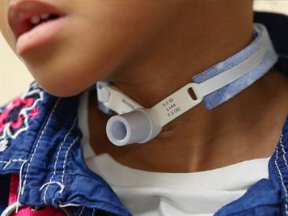
Youth with Special Health Care Needs
Interruption of services
Financial and prescriptive access for ongoing medication management
Loss of respite services

Slide 15
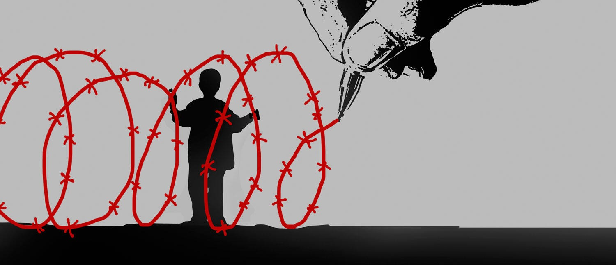
Youth in the Juvenile Justice System
Visits from family decreased
Increased risk of COVID-19 exposure

Slide 16
Foster Care Youth
Social distancing increases feeling of loneliness and isolation
Lack of daily contacts with friends and mentors
Can support outdoor visitations, more frequent technological contact, photographs, memory boxes

Slide 17
Grief
Racial and ethnic disparities in the rate of caregiver deaths
Professional counseling
Grief support groups

Slide 18
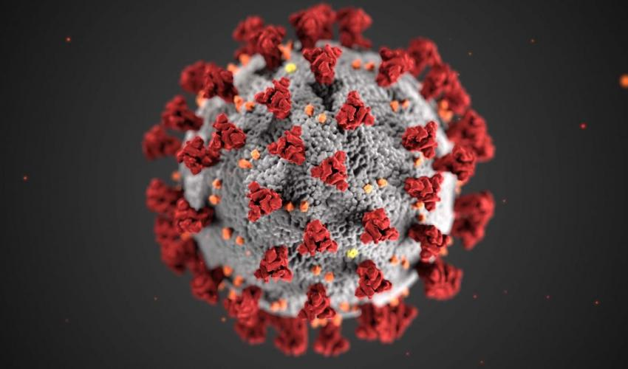
Effects of Pandemic

Slide 19
Suicide
Ideation
Positive screens for suicidal ideation have increased overall in youth presented in ED
Behavior
31% increase in mental health ED visits from 2019 to 2020
Increase especially prominent for girls
Notes:
Ideation
Positive screens for suicidal ideation have increased overall in youth presented in ED (Pediatrics, 2021)
From CDC (CDC, Morbidity & Mortality Weekly Report (2020) report in June:
During 2020, the proportion of mental health–related emergency department (ED) visits among adolescents aged 12–17 years increased 31% compared with that during 2019.
In May 2020, during the COVID-19 pandemic, ED visits for suspected suicide attempts began to increase among adolescents aged 12–17 years, especially girls. During February 21–March 20, 2021, suspected suicide attempt ED visits were 50.6% higher among girls aged 12–17 years than during the same period in 2019; among boys aged 12–17 years, suspected suicide attempt ED visits increased 3.7%.

Slide 20
Depression & Anxiety
Globally, significant increases in symptoms of anxiety and depression, as well as diagnosed disorders
In the US, depressive symptoms have continued to increase in adults over the course of the pandemic
Depression has increased for adolescents
Higher among girls and lonely individuals
Notes:
Globally, anxiety and depression symptoms doubled (Racine, et al., 2021): the pooled prevalence estimates of clinically elevated child and adolescent depression and anxiety were 25.2% and 20.5%, respectively. The prevalence of depression and anxiety symptoms during COVID-19 have doubled, compared with prepandemic estimates, and moderator analyses revealed that prevalence rates were higher when collected later in the pandemic, in older adolescents, and in girls.
Significant increase in the diagnosis od disorders: anxiety disorders up 25.6% and Major Depressive Disorders up 27.6% (Lancet, October 2021)
32.8% of U.S. adults experienced elevated depressive symptoms in 2021, compared to 27.8% of adults in the early months of the pandemic in 2020, and 8.5% before the pandemic.
Liu: Significant increases in depressive symptoms followed pandemic onset for boys and girls. However, this increase was earlier and more pronounced among girls than boys, whose depression only increased significantly during the persistent period and to a lesser degree. Trajectories of depression were influenced by loneliness and social connections.

Slide 21
Obsessive-Compulsive Disorder
Worsening of OCD symptoms, even in the face of ongoing treatment
Especially worsening contamination fears
OCD severity during the pandemic has also been found to be directly correlated with:
suicidal ideation, poor coping, sleep disturbances, family conflict, avoidance, anxiety, depression, and medication adjustments
Notes:
Worsening of OCD symptoms, even in the face of ongoing treatment (Zaccari et al, 2021)
Especially worsening contamination fears
OCD severity during the pandemic has also been found to be directly correlated with:
suicidal ideation, poor coping, sleep disturbances, family conflict, avoidance, anxiety, depression, and medication adjustments

Slide 22
Post Traumatic Stress
Pandemic increased the risk of multiple traumatic experiences and complex trauma
For vulnerable children, pandemic exacerbated disadvantage and may increase toxic stress
Notes:
Pandemic increased the risk of multiple traumatic experiences and complex trauma (Vezina et al, 2020)
For children living in socially disadvantaged environments characterized by poverty, the lack of access to developmentally appropriate resources, low levels of stimulation and responsive care, or inadequate supervision, the pandemic situation, by aggravated circumstances, may become an adverse childhood experience, generating toxic levels of stress (Holmes et al, 2020)

Slide 23
Increased Substance Use
July 2021 study reported increased rates of substance use for children admitted to inpatient psychiatry during the pandemic
Nearly twice as likely to use substances during the pandemic

Slide 24
Children with Autism Spectrum Disorder
2021 study compared families with children with ASD and non-ASD families during the pandemic
All families were BIPOC and low-income
Families with children with ASD
Greater changes in behavior, sleep difficulties, physical conflict among their children

Slide 25
Local Depression Data (PHQ-9)
Month | % Positive
 | 2020 | 2021
Jan | 19.07% | 27.73%
Feb | 18.88% | 26.78%
Mar | 19.82% | 26.74%
Apr | 20.60% | 24.94%
May | 11.78% | 15.62%
June | 8.64% | 11.17%
July | 8.89% | 10.20%
Aug | 11.45% | 12.81%
Sept | 16.82% | 22.05%
Oct | 19.84% | 23.21%
Nov | 23.23%
Dec | 24.55%
Notes:
Patient Health Questionnaire is a 9 item depression screen administered to adolescents age 11 and over in a number of Children’s departments:
PHQ-9 Screening for Patients ages 11 & older
Emergency Department
Urgent Care
Primary Care (14 locations across Nebraska and Council Bluffs)
Med Surg In-Patient Units
Specialty Care Clinics (Examples: Endocrine, Cystic Fibrosis, Oncology Survivorship, Foster Care)
Score 10 or higher, which indicates moderate depression

Slide 26
Local Suicide Deaths
2018: 4
2019: 5
2020: 11
By November, 2021: 11

Slide 27
Growth after Trauma

Slide 28
Post Traumatic Growth (PTG)
Growth in Five Areas:
Appreciation of life
Relationships with others
New possibilities in life
Personal strength
Spiritual change
Growth vs Distress
Personal rather than Common Factors
Notes:
Post Traumatic Growth is a developing area of research in psychology. Posttraumatic growth (PTG) is a concept describing positive psychological change experienced as a result of struggling with highly challenging, highly stressful life circumstances.
PTG looks for positive growth in five areas:
Appreciation of life.
Relationships with others.
New possibilities in life.
Personal strength.
Spiritual change.
Positive Refocusing & Reappraisal (Growth) VS Ruminating, Catastrophizing, and “Putting into Perspective” (Distress); (Zhen & Zhou, 2021)
Personally Important PTG more powerful positive predictor for self esteem than commonly defined PTG (Taku & McDiarmid, 2015)
NOT a silver lining, must avoid minimizing pain or loss
https://blogs.scientificamerican.com/beautiful-minds/post-traumatic-growth-finding-meaning-and-creativity-in-adversity/
https://hbr.org/2020/07/growth-after-trauma

Slide 29
Factors to address
Loneliness—duration can significantly influence depression symptoms appearing months to years later
Children who experience enforced isolation or quarantine 5 times more likely to need mental health services
Also more likely to have post traumatic stress
What to do with helplessness and uncertainty

Slide 30
College Students
Those enrolled in campus wellness program less affected by COVID in terms of internalizing symptoms and attention problems
Mood and daily wellness behaviors negatively affected by COVID pandemic

Slide 31
Resources & Supports

Slide 32
Indigenous Resources
Power Hour – noon Pacific time -- presentations, comedy, workshops and storytelling
Indigenous Story Studio
One Sky Center
WeRNative
StrongHearts Native Helpline 1-844-762-8483
Native Wellness Institute
National Indian Health Board’s COVID-19 Tribal Resource Center
CDC guidance on funeral and burial services, safe watering points and advice about physical distancing and coping with lockdowns
Navajo Department of Health

Slide 33
African American Resources
Black radio
BlackDoctor.org
Trusted Media figures
Places of worship
National Network to Eliminate Disparities in Behavioral Health (NNED)
Locator to find community-based organizations serving Black and Latino communities

Slide 34
Latinx Resources
Latinx Radio
Media figures
Places of worship
National Network to Eliminate Disparities in
Behavioral Health (NNED)
Locator to find community-based organizations serving Black and Latino communities

Slide 35
What Can We Do?
Disaster distress helpline 1-800-985-5990 or text TalkWithUs to 66746
National Suicide Prevention Lifeline 1-800-273-8255
Crisis Textline Text TALK to 741741
National Human Trafficking Hotline 1-888-373-7888; text 233733 “Help” or “info”
www.fns.usda.gov/partnerships/national-hunger-clearinghouse
Local food resources

Slide 36
Mental Health America
www.mhanational.org
Culturally competent strategies
Raise awareness about mental health
Promote proper, timely, effective treatment

Slide 37
What Can We Do?
National Network to Eliminate Disparities in Behavioral Health (NNED)
Locator to find community-based organizations serving Black and Latino communities
Smartphones – reduce digital divide
CDC notices and fact sheets in multiple languages
Public health concepts explained in culturally-competent language
Identify community-determined first responders
Not always police or fire
Often extended family members, pastors, neighbors

Slide 38
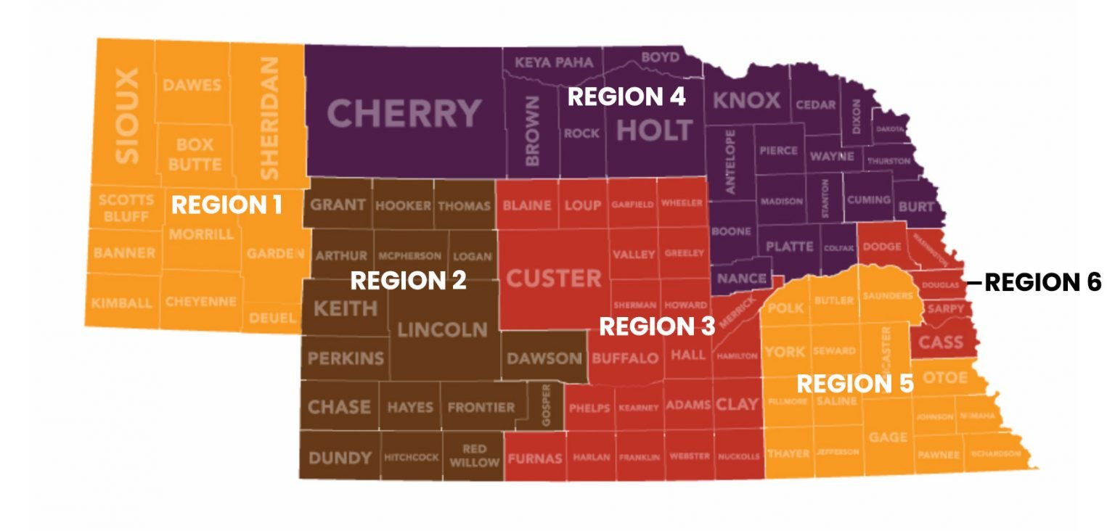
What Can We Do in Nebraska?
Kim Foundation: https://thekimfoundation.org/by-location/
Nebraska Family Helpline: https://dhhs.ne.gov/Pages/Nebraska-Family-Helpline.aspx
Boys Town Hotline: https://www.boystown.org/hotline/Pages/default.aspx

Slide 39
What Can We Do?
Frequent follow up and monitoring for subthreshold concerns
Check in with parents/caregivers/teachers about their own emotional well-being
Facilitate Resilience
Families provide strength by being present, empathic and nurturing
Practice together mindfulness, relaxation, focusing on the present moment
TAKE CARE OF YOURSELF!

Slide 40
Notes:
Additional resource for presentation: https://aspe.hhs.gov/sites/default/files/documents/0bcc372f4755cca29ebc80a47cfe300e/child-adolescent-mh-covid.pdf

