Slide 1
WHAT’S ON OUR STREETS ?
CURRENT TRENDS IN STREET DRUGS

Slide 2
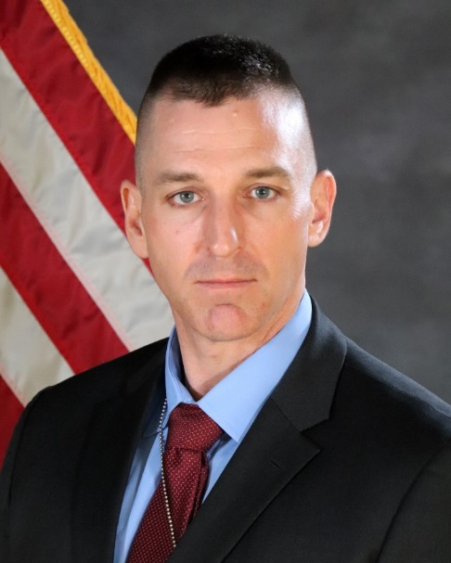
PRESENTER BIO
Lieutenant Eric Kauffman, Nebraska State Patrol
BS Criminal Justice from University of Nebraska
Serving Since 2003
Investigative Services Division
Troop A: Cass, Dodge, Douglas, Sarpy & Washington Counties
Graduate of Northwestern University Police Staff and Command School
No disclosures

Slide 3
GOALS & OBJECTIVES
At the conclusion of this presentation the students will:
Be able to identify the most commonly abused illicit drugs in the community
Increased awareness of suspicious activity
Identify community resources and ways to partner with area law enforcement

Slide 4
Legal Disclaimer
The following information is being provided for educational purposes, and is not intended to be legal advice and should not be construed as such. Due to the abbreviated nature of this presentation, we cannot cover every factor relating to these cases, and this is intended to be a general overview and introduction to the topic. Please contact your agency/company attorney, private counsel, or local County Attorney for legal advice.

Slide 5
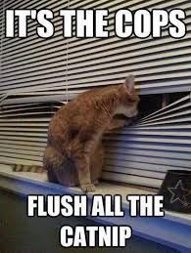
Source: askideas.com

Slide 6
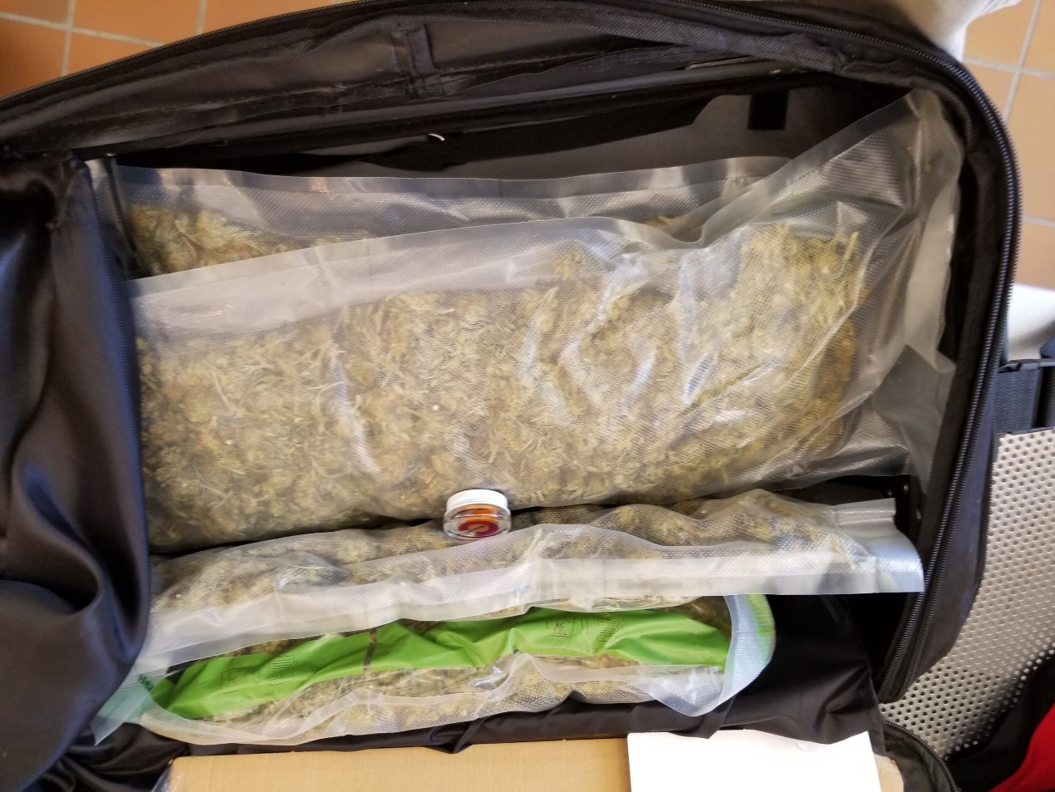
MARIJUANA
What’s new in the world of cannabis?
This is NOT the marijuana of the 1960’s
Higher Potency – Concentrates & Synthetics
Hemp & Delta-8

Slide 7
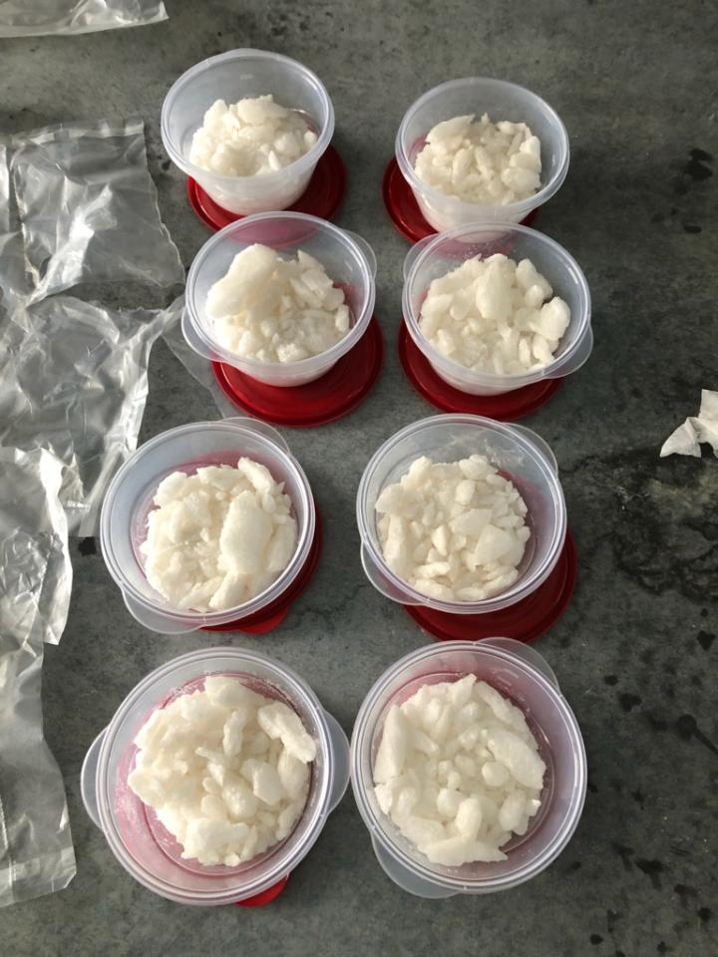
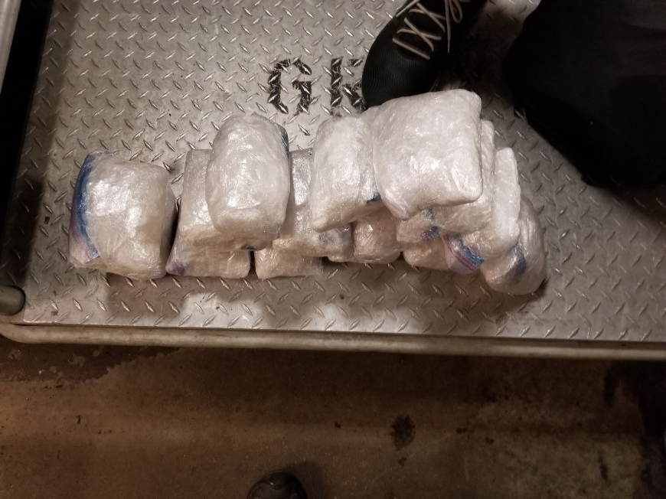
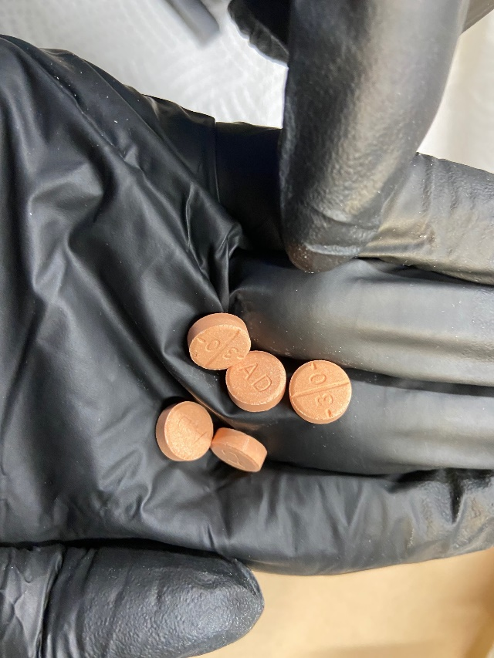
Methamphetamine
Pandemic caused short-term supply shortage
Purity levels continue to rise
Can be infused as a liquid
Pressed into pills

Slide 8
But the fastest growing trend continues to be…
Prescription drug abuse

Slide 9
The Epidemic Continues…
From 1999 – 2020 nearly 900,000 people died of a drug overdose
In 2020 alone, 91,799 died of a drug overdose
Nearly 75% of those involved opioids
On average 251 people die of drug overdoses everyday
Nearly 36 people a day die just from heroin
Early 2021 estimates show the numbers may be even HIGHER
SOURCE: Centers for Disease Control & Prevention, National Center for Injury Prevention and Control

Slide 10
What Does It Mean Locally?
2018 - 2019: 299 overdose deaths
2020: 232, 35% increase
Most likely to be male, between 25-64
44% involved opioids (National Average is 75%)
50.3 opioid prescriptions per 100 persons (National Average is 46.7)
High likelihood overdose deaths are under-reported.
SOURCE: CDC, National Institute on Drug Abuse, Nebraska Dep’t of Health & Human Services

Slide 11
Effects of the Pandemic
NPR Report
Nationwide – Overall18% increase in drug overdoses
Also an increase in fatal overdoses
ODMAP
Source: https://www.npr.org/sections/coronavirus-live-updates/2020/08/13/901627189/u-s-sees-deadly-drug-overdose-spike-during-pandemic

Slide 12
Commonly Abused Prescription Drugs
Hydrocodone (Vicodin)
Oxycodone (Oxycontin)
Methadone
Alprazolam (Xanax)
Tramadol
Zolpidem (Ambien)
Clonazepam (Klonopin)
Codeine (Lean, Purple Drank)
Methylphenidate (Ritalin)
Gabapentin
Morphine
Lorazepam (Ativan)
Dextroamphetamine

Slide 13
Commonly Abused Combinations
Opioid Syrup Trinity
Opioid, Benzo, Opioid Syrup
Blackout
Opioid, Benzo, Stimulant
Gaba Trinity
Opioid, Benzo, Gabapentin
Speedball
Opioid, Stimulant
Opioid & Benzo
Oxy & Hydrocodone
Holy Trinity
Opioid, Benzo, Carisprodal
Classic Trinity
Opioid, Benzo, Muscle Relaxant
Buprenorphine Trinity
Opioid, Buprenorphine, Muscle Relaxant
Source: Drug Enforcement Administration

Slide 14
Why Is There A Problem?
AVAILABILITY: Over 13,000 registrants in Nebraska who can issue prescriptions for a controlled substance
LACK OF KNOWLEDGE: Lack of knowledge and awareness of the problem by the public, law enforcement and prosecutors
AVAILABILITY + L.O.K = Greater accessibility and less likelihood of detection

Slide 15
PROMETHAZINE W/ CODEINE
Pacific Northwest
$1000 a pint
California
$3000 a pint
Texas
$2880 a pint
(high end)
Northeast
$1500-$2500 a pint
Omaha
$1500 a pint
Chicago
$2500 a pint
Southeast
$1000-$1500 a pint

Slide 16
What Is Drug Diversion?
The diverting of any licit drug from it’s legitimate purpose to an illegitimate purpose.
How is it done?
Burglary
Robbery
Other Types of Theft
Internal – Doctor, Nurse, Pharmacist, Staff
External – Delivery Company, Mail delivery
Fraud
Fraudulent calls / emails / faxes
Phony / stolen script pads
Doctor Shopping

Slide 17
Continued…
Forgery
Altered scripts
Improper Prescribing Practices
Overly sympathetic to patient’s pain
Attempt to earn illicit gains
Ignorance
Identity Theft
Shared/Stolen/Altered/Fraudulent PII
Fraudulent Billing
Dark Web
Use of cryptocurrency
Shop from home, delivered to your door

Slide 18
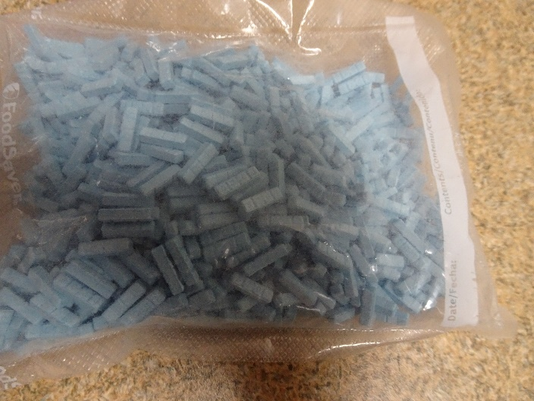
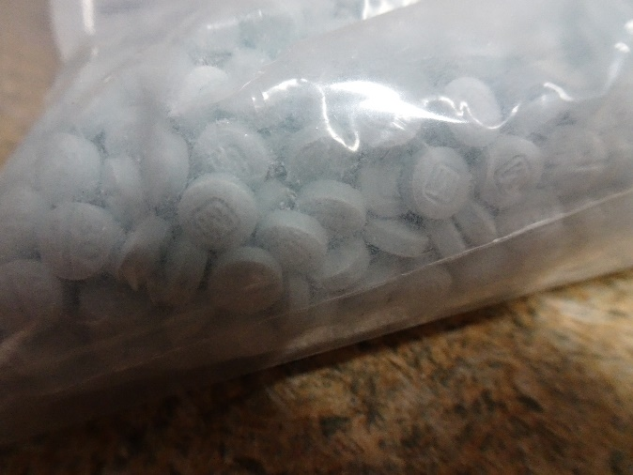
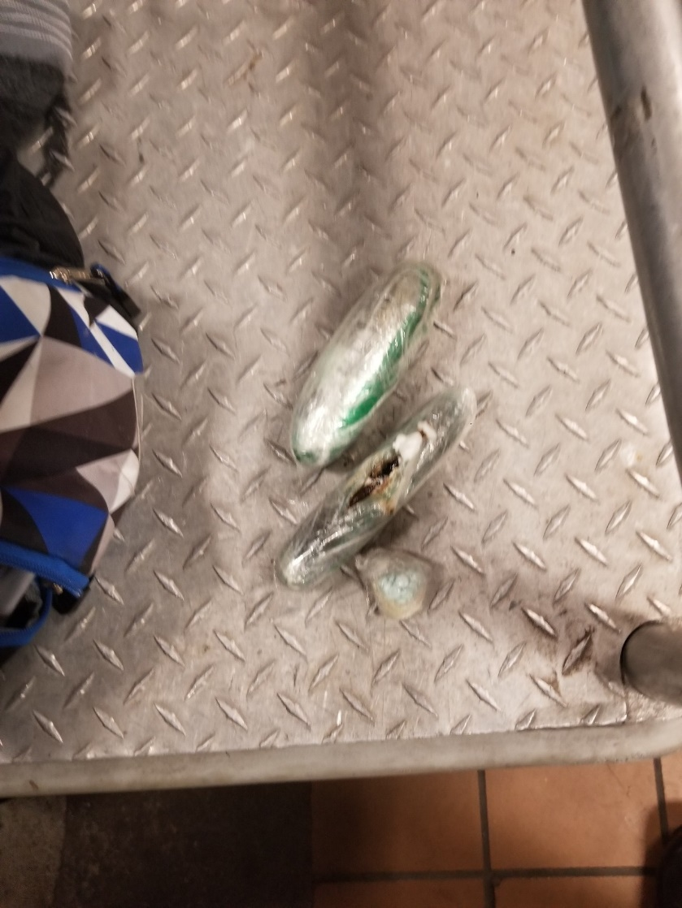
What We See on the Street

Slide 19
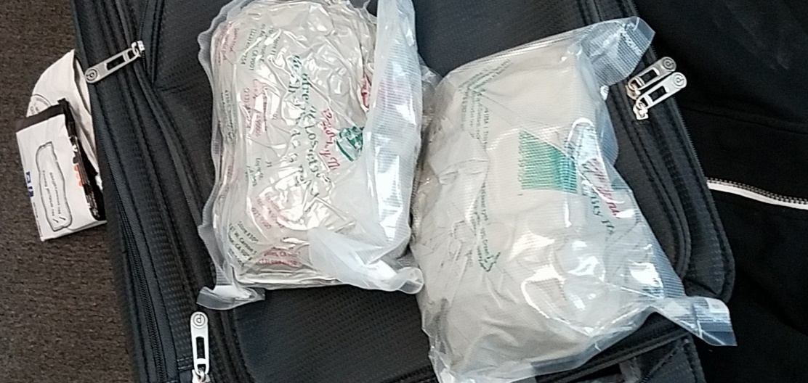
Fentanyl and it’s Analogues
50x – 100x more potent than morphine
25x – 50x more potent than heroin
Analogues include carfentanil, 3-methylfentanyl
Lethal in very small doses
Mexico and China are major sources

Slide 20
Detection?

Slide 21
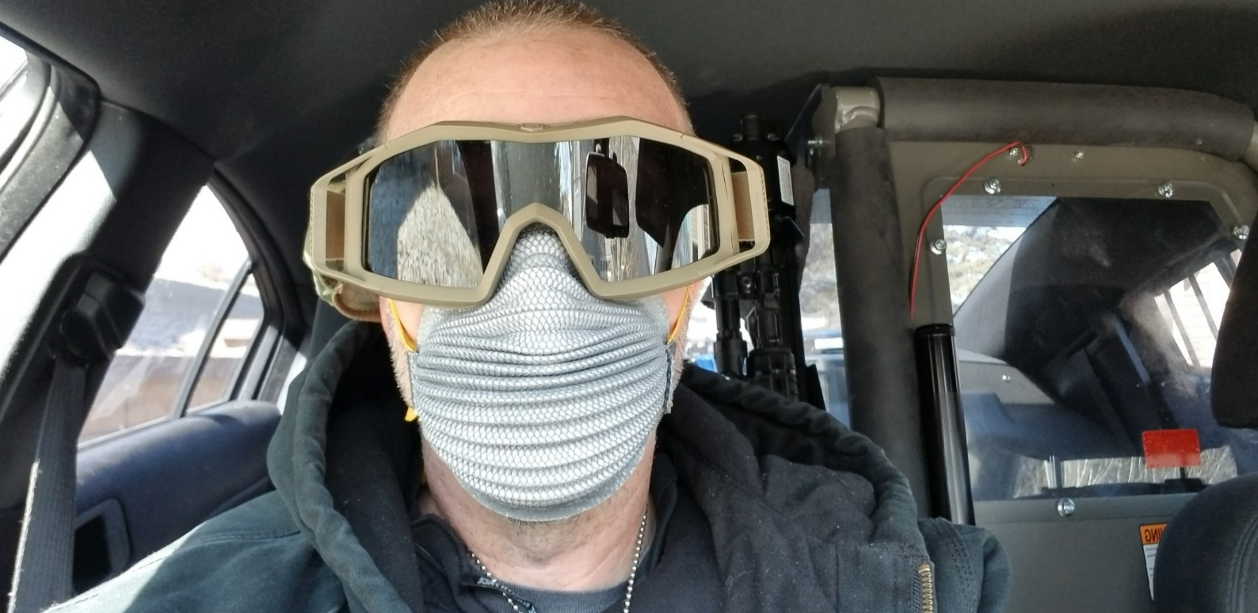
When In Doubt…
Use Universal Precautions!!!!

Slide 22
Good Samaritan Laws
Provides immunity for low-level drug and alcohol crimes to persons having an overdose as well as bystanders who call 911
LB439 passed in 2015. State Statute 53-180.05
LB487 passed in 2017. State Statute 28-472
State Statute 28-470 provides immunity to pharmacists who administer naloxone in good faith during a suspected overdose.

Slide 23
Community Resources
Prescription Drug Monitoring Program (PDMP)
Nebraska MEDS Coalition
Leftovermeds.com
Nebraska DHHS
Nebraska Pharmacist’s Association
Coalition Rx
Substance Abuse Addiction Services
Heartland Family Services
Lutheran Family Services
Many others

Slide 24
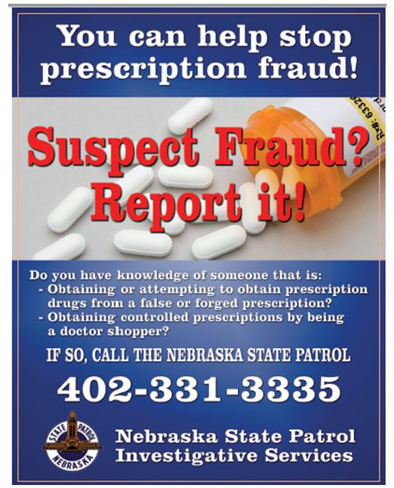
Law Enforcement Resources
State Patrol Diversion / Script Fraud Reporting
402-331-3335
Online Reporting
NSPTROOPAISO@NEBRASKA.GOV
DEA Drug Take Back Efforts

Slide 25
Closing / Questions ???
Lieutenant Eric Kauffman
402-595-2097

