Slide 1
COMMUNICABLE DISEASES 101 FOR SCHOOL HEALTH
Presented by Nebraska ICAP

Slide 2
Presenters
Daniel Brailita, MD
Assistant Professor in Infectious Diseases, UNMC
Associate Medical Director, NE ICAP; lead MD School Program
Public Health, Community Infection Prevention and Management, Telehealth
Chris Cashatt, BSN, RN, CIC
Infection Preventionist Specialist with 36 years of experience in Infection Prevention, Case Management, and Quality Control, Critical Care Nursing
Lead IP School Program
Josette McConville, RN,CIC
Infection Prevention Specialist experienced in Ambulatory Care, Acute Care, Employee Health, and Clinical Education.
IP School Program

Slide 3
No Disclosures
This Photo by Unknown author is licensed under CC BY-SA.

Slide 4
Nebraska Infection Control Assessment and Promotion Program (ICAP)
A joint effort of UNMC, Nebraska Medicine and NE DHHS, supported by the Nebraska DHHS HAI program since 2015
Assess infection prevention and control programs in various healthcare facilities in the State of Nebraska
Identify facility specific infection control gaps and make evidence-based recommendations for improvement
Analyze collective gaps and design mitigation strategies for improvement throughout the state
Assessments are offered at no cost or future obligation
Notes:
NE ICAP has been providing infection control and prevention assistance to a variety of facilities since 2015. NE ICAP is expanding to schools and Infection control and prevention trained nurses and physicians provide assessments to facilities that request them. NE ICAP is a non-regulatory organization that provides free and confidential assessments .They provide an outside eye that may help to improve on interventions that have already been put in place.

Slide 5
Nebraska ICAP School Initiative Goals
Develop IPC Assessment tool for schools
Pilot voluntary general IPC assessments of school IPC programs
Validate, share and integrate best practices from successful school IPC programs
Analyze data from pilot assessments to identify common IPC gaps
Develop new or connect schools IPC programs with already existing resources to mitigate the identified gaps
Launch a basic IPC certificate training course for school IPC program leads that incorporates lessons learned from the project
NE ICAP is a non-regulatory agency and provides assessments and resources at no cost to participating facilities.

Slide 6
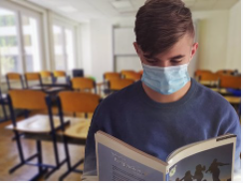
LEARNING OBJECTIVES
1. Understand what a reportable disease is and define an outbreak in a school setting
2. Describe how schools report communicable diseases to Nebraska public health departments
3. Recall three instances of communicable disease in school settings and appropriate mitigation steps

Slide 7
What is Infection Prevention & Control in Schools
Preventing the spread of infections by ensuring that kids can safely participate in-person learning and reducing absenteeism rates.
Maintaining a clean environment-Cleaning and Disinfection
Environmental Controls: Airflow
Medication Administration
Point of Care Testing
Injection Safety
Routine Immunizations
Hand Hygiene
Personal Protective Equipment
Blood & Body Fluid Exposures
Communicable Disease and Reporting
Notes:
NE ICAP has developed a School based infection prevention assessment tool to evaluate each individual school on each of these categories. These are the domains that are included in the assessment. NE ICAP is a non-regulatory agency that will make recommendations for improvement and work with schools to increase and strengthen their infection control/prevention strategies within the boundaries of each individual district. Our goal is to provide a resource for schools giving them access to experts in the fields of infection prevention.

Slide 8
DHHS TITLE 173 Communicable Diseases
Chapter 1 Reporting Of Communicable Diseases
Providers, clinics, critical access hospitals, and facility/place experiencing an outbreak
Reporting can be done by telephone, facsimile, other secure electronic mail system, or automated reporting systems.
Chapter 3 School Health, Communicable Disease Control, and Immunization Standards
Title 173 Ch 1 (nebraska.gov)

Slide 9
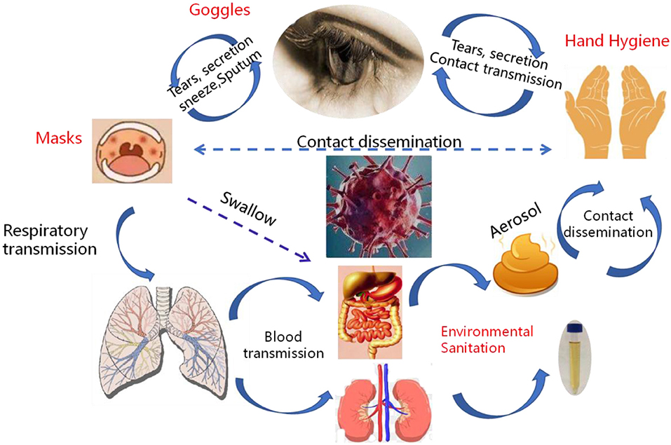
Communicable Disease
An illness due to an infectious or malignant agent, which is capable of being transmitted directly or indirectly to a person from an infected person or animal through the agency of an intermediate animal, host, or vector, or through an inanimate environment.
Title 173 Ch 3 (nebraska.gov)
This Photo by Unknown Author is licensed under CC BY

Slide 10
Reportable Communicable Diseases
Those diseases that are required by law to be reported pursuant 173 NAC 1
Communicable disease and other conditions that pose a threat to public health, including food poisoning, influenza, possible bioterroristic attack or an increased disease incidence beyond expectations
Title 173 Ch 1 (nebraska.gov)
Notes:
Reportable means required to report.

Slide 11
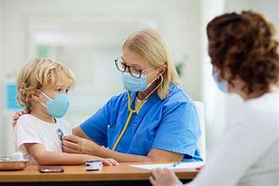
Outbreak Defined
The occurrence of one or more case of an illness of similar nature in persons of a community, institution, region, or other geographically defined areas which is clearly in excess of normal expectancy.
Title 173 Ch 3 (nebraska.gov)
This Photo by Unknown Author is licensed under CC BY-SA-NC
Notes:
An outbreak may be one case or more than what is normal for you. Tracking instances of contagious disease for your facility becomes important to know when it is more than your “norm”. I would love to hear from our audience on how they track illness’s in their facility. What kind of tools do you utilize?

Slide 12
How Do We Know it's an Outbreak
Foodborne Illness Outbreak Detection
Routine surveillance interviews
Some outbreaks are detected through routine surveillance activities that include interviewing all persons who are diagnosed with a reportable disease. An investigation is initiated when multiple cases report a common exposure, such as eating a common food item, eating at a common restaurant, or having contact with an identical water source, daycare, or school.
Reports of suspected foodborne illness
DHHS receives reports of suspected foodborne illness from the general public through local health departments
Healthcare providers may report suspected foodborne illness outbreaks if they see an unexpected number of patients with gastrointestinal illness.
Restaurants, daycare providers, schools, and health care facilities (i.e., hospitals, long-term care facilities) may also report outbreaks to LHD.

Slide 13
Outbreak Definitions- Detailed
Epidemic refers to an increase, often sudden, in the number of cases of a disease above what is normally expected in that population in that area.
Outbreak carries the same definition of epidemic but is often used for a more limited geographic area.
Cluster refers to an aggregation of cases grouped in place and time that are suspected to be greater than the number expected, even though the expected number may not be known.
Pandemic refers to an epidemic that has spread over several countries or continents, usually affecting a large number of people.

Slide 14
Examples of Outbreaks Measles cases in 2022
As of February 3, 2022, a total of zero measles cases have been reported.
https://www.cdc.gov/measles/cases-outbreaks.html

Slide 15
R0 number of Pediatric Contagious Illnesses if NO Immunization

Slide 16
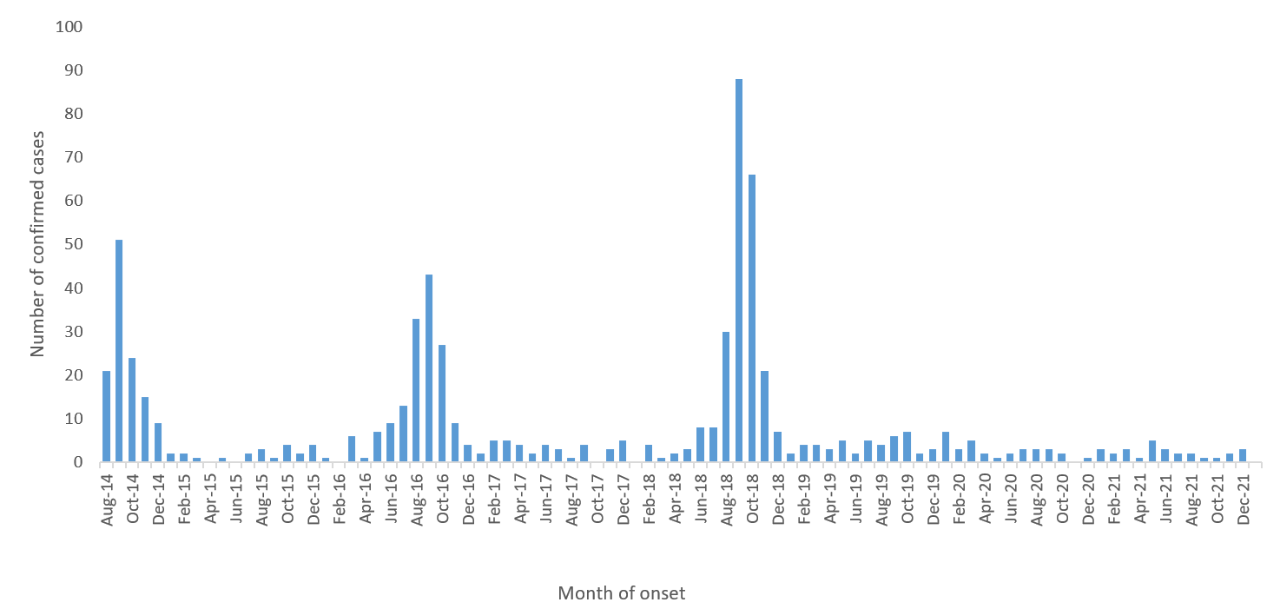
Not all Outbreaks are Immediately Visible...
AFM- Acute Flaccid Myelitis in Children
- As of February 10, 2022, there have been 28 confirmed cases in 2021 out of 59 reports of patients under investigation (PUIs) and no confirmed cases in 2022 out of 3 PUIs.
There have been 678 confirmed cases since CDC began tracking AFM in August of 2014. CDC has been thoroughly investigating cases since that time. Increases in AFM cases, mostly in young children, in 2014, 2016 and 2018.
https://www.cdc.gov/acute-flaccid-myelitis/cases-in-us.html

Slide 17
Who is required to report communicable disease
Providers
Clinics
Critical access hospitals
Hospitals
Any facility who experience an outbreak.
Title 173 Ch 3 (nebraska.gov)

Slide 18
SCHOOL NURSE RESPONSIBILITY
1-007.04 Responsibilities of Schools: School nurses or those acting in the capacity of a school nurse must, in accordance with state and federal statutes:
1. Notify the local public health department or the DHHS Division of Public Health of cases or suspected cases of reportable diseases as indicated in 173 NAC 1- 004.01 and 1-004.02, or outbreaks and suspected outbreaks of diseases as indicated in 173 NAC 1-004.01B affecting students and/or other school-affiliated personnel and which present a reasonable threat to the safety or health of a student and/or other school-affiliated personnel; and
2. Cooperate with public health authorities in obtaining information needed to facilitate the investigation of cases and suspected cases, or outbreaks and suspected outbreaks of diseases affecting students and/or other school-affiliated personnel
Title 173 Ch 3 (nebraska.gov)
Notes:
Whoever acts in the capacity of a school nurse (health para) Reporting can escalate a case to the health department and lets them know when they need to bring others in to help. Families who may have kids going to different schools. May be other cases that your school is not aware of. Brings it to the attention of the public health department.

Slide 19
Reporting 101
When a school nurse or individual acting in the capacity of a school nurse identifies a case or suspected case of a reportable disease, she/he must report case to the local health department or the DHHS Division of Public Health.

Slide 20
Surveillance
Electronic Reporting
Electronic Health Reporting (EHR)-share information from all the healthcare providers, regardless of the health organizations. In a school setting EHRS have the capability to manage data and share it with members of the health care team outside of the school setting and can serve to optimize coordination of care.
Electronic Lab Reporting (ELR)-labs are required to report communicable diseases directly to the health department.
Influenza report- Schools are required to report influenza-like clusters or outbreaks to the local public health department or DHHS
School Surveillance Weekly Form
Nebraska Local Health Departments (nalhd.org)
Nebraska-Immunization-Information-System.aspx (NESIIS)
Nebraska Influenza & Other Respiratory Disease Report
Notes:
Surveillance is a way to track the number of cases of each type of illness that schools encounter every year. Lab identified diseases are reported directly through electronic reports to DHHS. This would be the entire list of diseases in chapter 1 of Title 173.

Slide 21
DHHS School Surveillance Weekly Form
Please return form to: Name __________________________
Fax: _______________ Phone: ___________________ Email: ___________________
Name of School: __________________ School District: __________________________
County: ______________
Name of School Contact Person: ________________________________
Phone Number (______) __________________________
Please indicate the school type. Please check all that apply.
□ Primary □ Elementary □ Intermediate □ Middle / Junior High □ High / Senior High
Reason for school closure (please circle): Holiday Weather Illness
Other (please describe) __________________________
Date of Closure: __________________ Expected Return Date: ____________________
Total Enrollment (please circle): Same Change If changed, new enrollment: ______
Total Faculty (please circle): Same Change If changed, total faculty: ______
Date of Report (month/day/year): _______________
REASON FOR ILLNESS | STUDENTS
Influenza-like Illness (upper respiratory)
Symptoms: fever, cough and/or sore throat
(may have additional symptoms)
Gastrointestinal Illness Symptoms: nausea,
vomiting, diarrhea, no cough
Rash/Fever (must have both)
a. Hand, Foot & Mouth
b. Chicken Pox
c. Measles
d. Scarlet Fever
e. Other
Strep Throat
Asthma
OTHER - Please Specify
Unknown
TOTAL ABSENT
Notes:
With small numbers, trends are difficult to track on your own. DHHS does not require schools to report weekly, but reporting an outbreak immediately is required. This form can be found under the “flu” tab at DHHS, Flu Information For Schools. DHHS and local public health departments monitor rates of school absenteeism, as part of the School Illness Absenteeism Surveillance Program. Rates above 11% indicate transmission of illness and show that illness is transmitting in both the schools and community. Report weekly to LHD. Your LHD is responsible to update the information on the Guardian system and to notify DHHS of any outbreaks or school closings.

Slide 22
What Does The LHD Do With The Information
Communicable disease and other conditions that pose a threat to public health.
STD’s
Hepatitis
TB
Chicken Pox
Influenza
Determine exposures to vulnerable individuals.
Contact Tracing
Notify exposed individuals of exposure
Monitor Treatment
TITLE 173 Chapters 1 & 3
Notes:
Infectious diseases can pose a serious problem for immunocompromised individuals. Many diseases, if left untreated, can lead to severe illness. The public health department will contact infected individuals to determine the seriousness of the disease and possible exposures. They will then perform contact tracing and follow up with individuals who may have been exposed. The identity of the individuals are kept private to provide confidentiality.

Slide 23
WHAT INFORMATION IS NEEDED TO REPORT
Suspicion of a contagious disease
Signs and Symptoms observed
Contact information if requested by your local health department
Notes:
Does not have to be confirmed by a physician to report

Slide 24
NE ICAP: Table of Communicable Diseases
Notes:
Chapter 3 of Title 173 has a list of the most, commonly seen, reportable diseases in schools in Nebraska. Included on the list is the incubation period, symptoms of illness, infection period, and minimum isolation periods and control methods.

Slide 25
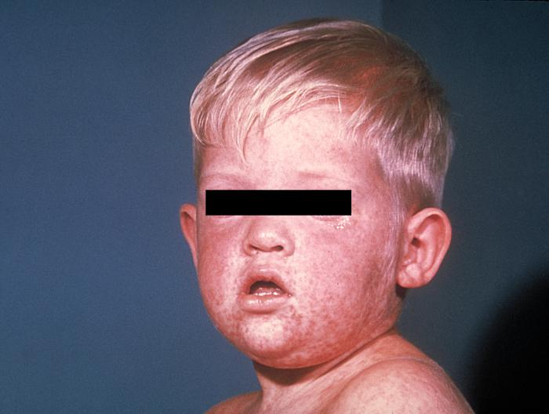
REPORT IMMEDIATELY TO YOUR LOCAL HEALTH DEPARTMENT
Diphtheria
Measles (Rubeola)
Meningitis (bacterial)
Pertussis (Whooping Cough)
Poliomyelitis
Rubella (German Measles)
Tuberculosis
This Photo by Unknown Author is licensed under CC BY-SA
TITLE 173 Chapters 1 & 3
Notes:
Chapter 1 of Title 173 has a comprehensive list of communicable diseases that require mandatory reporting. Most of the diseases listed will be reported by labs performing the test and physician offices or other healthcare entities.

Slide 26
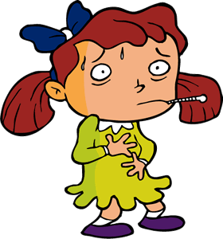
TITLE 173: 3-003 Exclusions From School
Children showing any signs or symptoms of a contagious or infectious disease are required by law to be sent to their homes immediately, or as soon as safe and proper conveyance can be found. Teachers are encouraged to observe each child carefully for signs of illness each time the child returns to school.
This is particularly important when epidemic diseases are known to be present in the community. The presence of one or more of the following signs or symptoms should make the teacher suspect a communicable disease: Fever, flushed face, headache, aches in muscles or joints, unexplained tiredness or listlessness, loss of appetite, stomach ache, nausea or vomiting, diarrhea, convulsions, sore throat, nasal congestion or discharge, unexplained skin eruption, sore or inflamed eyes
Title 173 (nebraska.gov)

Slide 27
IMMUNIZATION STANDARDS
Each student must be protected by immunization against the following diseases, unless otherwise exempted from this requirement under the provisions of 173 NAC 3-010:
Measles
Diphtheria
Invasive pneumococcal disease
Mumps
Tetanus
Rubella
Pertussis
Polio
Haemophilus
Influenzae type b (Hib)
Hepatitis B
Varicella
Notes:
It will be important to be able to access which students are not up to date on immunizations if and when an outbreak is detected.

Slide 28
Case Studies

Slide 29
Case Study #1
The school basketball coach inquires of the school nurse and absentee officer, “is something is going around?”
He has been notified that four team members have called out sick with the stomach flu and the big game is tonight.
Records indicate that 6 students are absent from school related to gastrointestinal complaints.
5 of the 6 absent students are on the basketball team.
Coach groans, “I told my wife that the spaghetti sauce at the team meal last night tasted ‘off’.”
Are you going to report to your local health department?
Notes:
School population is 300. School absenteeism reports indicate that it is reasonably expected for 2-3% of students to call in with gastrointestinal complaints weekly.

Slide 30
Identification
Cluster is identified, unknown cause of illness
Notification
Report cluster to the proper school authority per facility policy and to the local public health department
Exclusion
Students and staff that are having symptoms consistent with outbreak (diarrhea, nausea, vomiting, fever). Refer to healthcare provider
Prevention
After consultation with school authority and LHD, notify parents regarding outbreak, include: symptoms, mode of transmission, illness reporting, importance of hand hygiene and disinfection
Conduct surveillance for cases of diarrheal illness
Compile a list of affected students and staff by classroom.
Educate staff on proper hand hygiene and environmental disinfection.

Slide 31
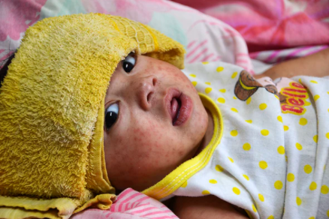
Case Study #2
Parent of a pre-K student calls to notify school that physician has diagnosed child with Measles.
Child missed class the prior two days for reported fever and cold like symptoms.
The absentee officer recognizes Measles as a reportable illness and the call triggers her to involve others in the situation immediately.
Child’s teacher notes that the child missed a full week of class two weeks ago when traveling “out of state” with her family.
School nurse quickly recognizes this child as one of 6 non-vaccinated students in the school. Child has a religious exemption.
Pre-K classroom is in the elementary school building (Pre-K through 4th grade).

Slide 32
Identification
Diagnosis reported to school by parent
Notification
Report immediately to the proper school authority per facility policy and to the local public health department
Exclusion
Prevention
Vaccine education What If You Don't Vaccinate Your Child? (immunize.org)
Infected child excluded for duration of illness and for no less than 4 days after onset of rash
Identify and exclude unimmunized children on same campus from date of diagnosis of first case until 14 days after rash onset of last known case
Working in conjunction with LDH, notification of exposures.
Notify parents regarding outbreak: symptoms, mode of transmission, illness reporting, importance of hand hygiene and disinfection
Notes:
Highly contagious. Incubation period 10-15 days. Clinical Presentation: Fever, dry cough, conjunctivitis, runny nose, sneezing, reddish-brown skin rash starts at head and spreads to whole body, lethargic, loss of appetite, watery eyes, photophobia, generalized body aches.
Does school have a way to identify (vaccinated) students with compromised immune symptoms?
Post exposure vaccine within 72 hours or immune globulin within 6 days when available.
? Similar recommendations for varicella case?

Slide 33
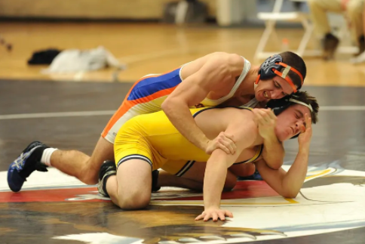
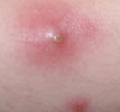
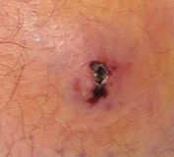
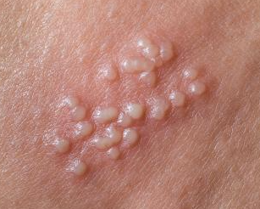
Case Study #3
Junior wrestler reports to the nurse’s office with complaints of a spider bite near his right axilla.
He reports that at least two other teammates also have had spider bites and his mom wants to make sure the wrestling room is exterminated as soon as possible.

Slide 34
Which one is the Spider Bite?
1. MRSA
2. Brown Recluse
3. Herpes Gladiatorum

Slide 35
Identification
Recognize potential cluster
Notification
Report cluster to LHD
Exclusion
Exclusion generally not necessary
Prevention
Shower immediately after practice
Do not share bar soap, towels, uniforms, gear, razors
Wash towel after each use using hot water and detergent, bleach preferrable. Dry on high heat setting
Change and clean your uniform every day
Clean your headgear daily with soap and water
Wash your hands before and after practice and competitions
Report any skin sores or blisters to your coach, athletic trainer, or parents immediately. Do not pick or squeeze skin sores
Enhanced disinfection of wrestling room (mats) and locker room
Wrestling – Nebraska School Activities Association (nsaahome.org) (Sports Medicine tab)
Notes:
Similar case study for herpes gladiatorum. Clinical presentation: fever (especially during first episode), swollen lymph nodes, sore throat, tingling feeling on the skin, cluster (usually more than one) of clear, fluid-filled blisters

Slide 36
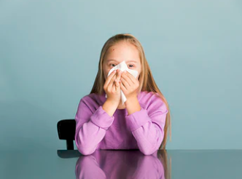
Case Study #4
2nd grade student was absent from school for one week approximately 2 months ago due to influenza like illness (cough, body aches and fever).
The student has continued to have chronic cough for greater than two months. Teacher has promoted respiratory hygiene and covering the cough with good compliance.
Child starts crying at school after a coughing episode that produced bloody sputum. She is sent to the school nurse’s office. School recommends that the parents take the child to her primary care provider related to symptoms, including increased fatigue and decreased endurance in class and activities.
Notes:
Physician investigation of case, includes suspect chest xray. Assessment of recent travel indicates that the mother and children spent 6 weeks in Brazil visiting family two summers (18 mos) ago.

Slide 37
Identification
School notified by LHD that student is highly suspected to be infected with active Tuberculosis (Tb)
Notification
Notify parents of exposed students and exposed staff
Exclusion
Infected child excluded until improving clinically on effective therapy. Child must be medically cleared to return to school (i.e., three consecutive negative sputum smears or testing of gastric aspirate)
Prevention
Work in conjunction with LHD to offer testing to exposed students/staff
Exposed students do not require exclusion
Educate teachers and staff of disease process
Notes:
Comment here about the likeilhood of transmission of similar mechanism illnesses

Slide 38
Request An ICAR (Infection Control Assessment Risk)
Contact NE ICAP for questions or to set up a visit
https://icap.nebraskamed.com
phone 402-552-2881

