Slide 1
Name that Rash— Common Pediatric Skin Problems
Patty Peska, APRN-CPNP-PC
Missi Schembari, APRN-CPNP-PC

Slide 2
Objectives
Participants will be able to identify distinguishing features of common childhood rashes
Participants will be able to discuss the management & treatment of common childhood rashes
Participants will be able to triage concerns for a rash
Participants will be able to identify if a child can remain in the classroom or will need to be sent home

Slide 3
Rashes
There are more than 12 million office visits annually for rashes and other skin concerns in children and adolescents
68% of those 12 million visits are made to a child’s PCP
Important considerations to aid in diagnosis and treatment of rashes:
Appearance of rash
Location of rash
Clinical course
Associated symptoms (i.e. pruritus, fevers, diarrhea, sore throat)
Notes:
In order to make an accurate diagnosis and plan of care, several factors must be taken into consideration

Slide 4
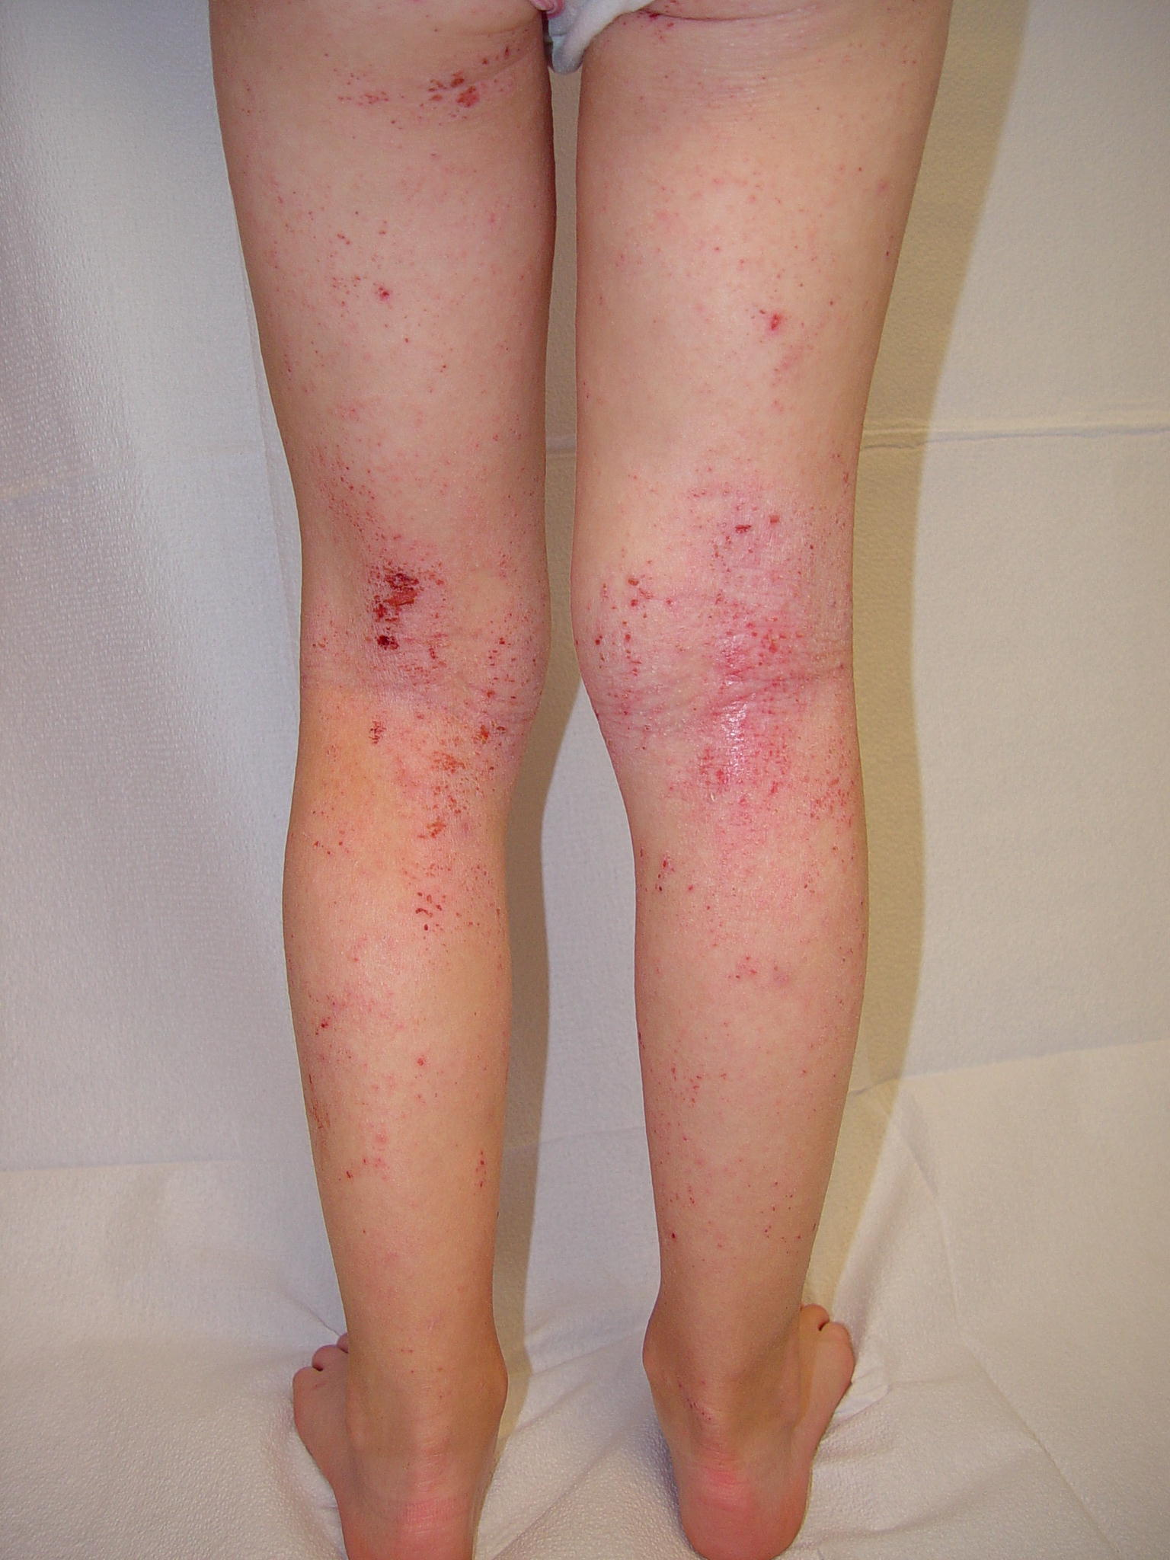
Case Study
8 -year-old Sara is sent to the nurse’s office for a rash on the backs of her arms and legs. Sara reports that the rash is “super itchy”. After calling mom, you learn that Sara has very dry skin always and the rash seems to flare-up at various times of the year. Sara has a history of asthma and seasonal allergies. Sara does not have a fever today in your office and seems healthy despite a slight runny nose.
https://www.bing.com/images/search?view=detailV2&ccid=euhLJrcN&id=57498184839D870215C2956D2BFCD841B5ED4E91&thid=OIP.euhLJrcNrMHmovljBa0_0AHaEt&mediaurl=https%3a%2f%2fstatic.lifetimedaily.com%2fapp%2fuploads%2f2017%2f10%2f24185826%2fTypes-of-Eczema.jpg&cdnurl=https%3a%2f%2fth.bing.com%2fth%2fid%2fR7ae84b26b70dacc1e6a2f96305ad3fd0%3frik%3dkU7ttUHY%252fCttlQ%26pid%3dImgRaw&exph=560&expw=880&q=eczema&simid=608025837139535857&ck=77443EF618313B615CF3FECA25833DE4&selectedIndex=24&FORM=IRPRST

Slide 5
What is this rash? A) Eczema B) Viral Exanthem C) Bed Bugs D) Henoch-Schonlein Purpura (HSP)

Slide 6
Atopic Dermatitis (Eczema)
GOALS of treatment are to reduce symptoms, prevent exacerbations, & prevent secondary skin infections.
Management Plan:
1) Identify triggers: Avoid harsh soaps and detergents, contact with wool/synthetic clothing, perfumes, trigger foods, very dry hot air, or becoming too hot and sweaty
2) Humidify the home, keep nails short.
3) Maintain adequate hydration: Bathe in lukewarm water using mild soap. Avoid excessive bathing
4) Soak and Seal: Moisturize with an emollient such as Aquaphor or Eucerin within minutes of bath. Ointments are better than creams.
5) Topical steroid cream: Are used in conjunction with emollients and are often the mainstay of therapy. Avoid application of steroids to face and genitalia. Use the lowest potency during exacerbations and for a limited time (usually no more than 7 days)
Notes:
Eczema is a chronic, pruritic, inflammatory skin condition that occurs most frequently in children, but it may also affect adults. Clinical features of eczema include skin redness, dryness and oozing and crusting. Intense itching is the hallmark of the condition. Eczema often looks different in people of different ages.
Babies---affects the front of the arms and legs, cheeks, or scalp. The diaper area is usually NOT affected
Older children and adults---affects the sides of the neck, the elbow creases, and backs of the knees. Older children & adults may also have patches on their wrists, hands, forearms and face
The management of eczema requires a multifaceted approach that aims to eliminate exacerbating factors, restore the skin barrier function & hydration of the skin, provide patient education, and offer pharmacologic treatment of the skin inflammation.
Topical steroid creams: if eczema is not improving with above measures, child should be seen in clinic because topical steroids may need to be prescribed. The choice of steroid potency is determined by the patients age, body area involved and degree of skin inflammation.

Slide 7
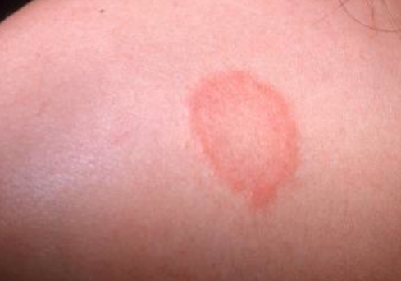
Case Study
Tom, a 12 –year- old boy, is sent to the nurse’s office for the following rash. The rash is on his arm and according to Tom has been present for 2 weeks. The rash is oval in shape with rough, scaly borders and central clearing. Tom reports that the rash is pruritic.
After calling Tom’s mom to discuss the rash, you learn that they have been applying 1% hydrocortisone cream to the rash BID for 1 week and have seen no improvement. Mom also reports that her son has been afebrile and has no URI symptoms. Tom is a wrestler. The family has a dog. No one else in the family has a rash.

Slide 8
What is this rash? A) Nummular Eczema B) Pityriasis Rosea C) Tinea Corporis D) Urticaria

Slide 9
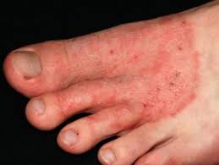
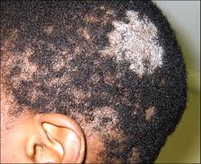
Tinea Corporis (Ringworm)
Lesions are erythematous, ring-shaped and are sharply marginated with a scaly border.
Develops when dermatophytic fungi invade the outer skin layers at the affected body region.
Tinea Capitis: ringworm of scalp
Tinea Corporis: ringworm of body
Tinea Cruris: jock itch
Tinea Pedis: ringworm of the feet
Acquired by direct skin contact with an infected individual or animal, contact with fomites, or from secondary spread from other sites of dermatophyte infection.
Notes:
Incubation period is 1-3 weeks

Slide 10
Question
What would you recommend mom do to treat Tinea Corporis?
A) Reassure Tom & his mom that it is a self-limiting rash and will go away on its own.
B) Recommend OTC antifungal cream be applied BID for 1-3 weeks
C) Recommend mom schedule an appointment for Tom to see his PCP because he will need to be placed on a short course of oral griseofulvin.
D) Tell parents that Tom cannot return to school or wrestling until the lesion is completely resolved.

Slide 11
Tinea Corporis – Management
Answer: B-OTC antifungal
OTC antifungal-clotrimazole (lotrimin) or miconazole are usually effective. Apply cream to the lesion and surrounding area of normal skin BID until resolved, which may take 1 to 3 weeks.
Systemic medication-Griseofulvin for patients with extensive infection or patients who fail topical therapy. Tinea capitis (ringworm of the scalp) MUST be treated with oral medications because the fungal infection is found at the root of the hair follicles, where topical agents do not reach.
Identify and treat contacts, educate about communicability, exclude from daycare or school for 24 hours after start of treatment.
Athletes with tinea corporis can participate in matches 72 hours after commencement of topical therapy and when the infected area can be covered.
Notes:
Athletes with tinea corporis can participate in matches 72 hours after commencement of topical therapy; it’s recommended that they be treated for a minimum of 1 week after lesion has resolved; may be covered with a bio-occlusive dressing when no longer considered contagious
For tinea capitis, the infection is more difficult to treat and requires 14 days of oral antifungal medication before return to practice or competition, Since shedding of fungal spores can persist beyond two weeks, it is recommended if possible washing scalp with ketoconazole 1% shampoo to decrease transmission of spores.
Tinea cruris is a groin infection. Treatment with topical antifungal is usually adequate. As lesion is covered by the uniform no exclusion from participation is usually needed.

Slide 12
Tinea Corporis-Prevention
Do not share clothing, sports equipment, or towels with other people.
Always wear slippers or sandals when at the gym, local pool, or other public areas.
Wash thoroughly with soap & shampoo after any sport involving skin-to-skin contact.
Wash all workout clothing after each practice in hot water and drying on high heat setting
Avoid tight fitting clothing. Change socks and underwear daily.
Keep skin dry and clean. Dry thoroughly after bathing.
Put your socks on before your underwear if you have athlete’s foot to prevent the spread of infection to other parts of your body.
Have your pet seen by their vet if they have patches of missing hair or a rash.
If someone in your family has symptoms of ringworm, have them treated right away to decrease chances of spreading infection to other family members

Slide 13
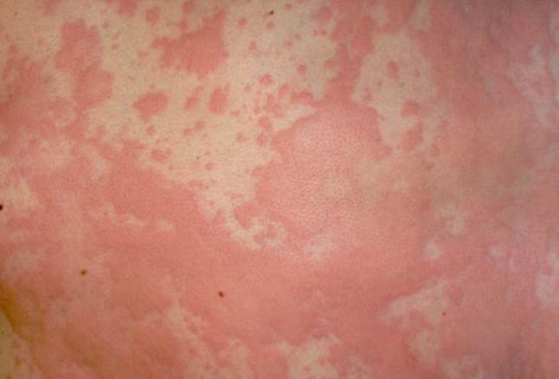
Case Study
11-year-old Jake is sent to the nurse’s office with this rash. He tells you the rash is extremely itchy. He is afebrile. He denies any new foods, lotions, soaps, detergents, or any recent URI symptoms. He also denies having any breathing problems or complaints of stomachache. He has no history of any allergies. There is no evidence of lip/eye/tongue swelling and his lungs sound clear.

Slide 14
What is this rash? A) Contact Dermatitis B) Urticaria or Hives C) Henoch-Schonlein Purpura (HSP) D) Insect Bites

Slide 15
Urticaria (Hives)
Circumscribed, raised erythematous plaques, often with central pallor
Usually round, oval or serpiginous in shape, ranging from <1cm to several cm in diameter
Intensely itchy----often worse at night
Transient
NOT painful & resolve without leaving ecchymotic marks
Any area of the body may be affected
Causes
Infections—viral, bacterial, and parasitic
Allergic reactions to meds, foods, insect bites/stings
Ingestion of NSAIDs
Often underlying cause is unknown
Notes:
Urticarial lesions or hives are circumscribed, raised, erythematous plaques, often with central pallor. Lesions may be round, oval, or serpiginous in shape and vary in size from less than 1 centimeter to several centimeters in diameter. They are intensely itchy. Pruritus may disrupt work, school, or sleep. Symptoms often seem most severe at night.
Individual lesions are transient, usually appearing and enlarging over the course of minutes to hours and then disappearing within 24 hours. Urticarial lesions are not normally painful and resolve without leaving residual ecchymotic marks on the skin, unless there is trauma from scratching
Any area of the body may be affected, although areas in which clothing compresses the skin (eg, under waistbands) or where skin rubs together (axillae) are sometimes affected more dramatically. Typically, compressed areas become more severely affected once the restricting clothing has been removed
Common causes of hives include:
infections: associated with over 80 percent of cases of acute urticaria in kids
allergic reactions to medications: most frequently implicated in causing hives include are penicillins and cephalosporins
foods: Milk, eggs, peanuts, tree nuts, soy, and wheat are the most common foods to cause generalized urticaria in children
insect stings and bites, reactions to medications that cause non-allergic mast cell activation (eg, narcotics); and ingestion of nonsteroidal anti-inflammatory drugs (NSAIDs
Urticarial lesions or hives are circumscribed, raised, erythematous plaques, often with central pallor. Lesions may be round, oval, or serpiginous in shape and vary in size from less than 1 centimeter to several centimeters in diameter. They are intensely itchy. Pruritus may disrupt work, school, or sleep. Symptoms often seem most severe at night.
Individual lesions are transient, usually appearing and enlarging over the course of minutes to hours and then disappearing within 24 hours. Urticarial lesions are not normally painful and resolve without leaving residual ecchymotic marks on the skin, unless there is trauma from scratching
Any area of the body may be affected, although areas in which clothing compresses the skin (eg, under waistbands) or where skin rubs together (axillae) are sometimes affected more dramatically. Typically, compressed areas become more severely affected once the restricting clothing has been removed
Common causes of hives include:
infections: associated with over 80 percent of cases of acute urticaria in kids
allergic reactions to medications: most frequently implicated in causing hives include are penicillins and cephalosporins
foods: Milk, eggs, peanuts, tree nuts, soy, and wheat are the most common foods to cause generalized urticaria in children
insect stings and bites, reactions to medications that cause non-allergic mast cell activation (eg, narcotics); and ingestion of nonsteroidal anti-inflammatory drugs (NSAIDs

Slide 16
Treatment of Hives
Initial treatment should focus on short-term relief of pruritus and angioedema, if present
2/3 of cases will be self-limited and resolve spontaneously
H1 antihistamines
First generation—Benadryl, hydroxyzine
Second generation—Claritin, Zyrtec, Allegra **preferred over 1st generation because they are less sedating, have fewer side effects, fewer drug-drug-interactions, and require less frequent dosing
Notes:
Initial treatment of new-onset urticaria (with or without angioedema) should focus on the short-term relief of pruritus and angioedema, if present. Approximately two-thirds of cases of new-onset urticaria will be self-limited and resolve spontaneously
H1 antihistamines — H1 antihistamines may be divided into older, first-generation agents (eg, diphenhydramine, chlorpheniramine, hydroxyzine) and newer, second-generation agents (eg, cetirizine, loratadine, fexofenadine
Second-generation agents are preferred for both adults and children
The newer, second-generation H1 antihistamines are recommended as first-line therapy by published guidelines from both allergy and dermatology expert panels [48,49]. These drugs are minimally sedating, are essentially free of the anticholinergic effects that can complicate use of first-generation agents, have few significant drug-drug interactions, and require less frequent dosing compared with first-generation agents [50-54].

Slide 17
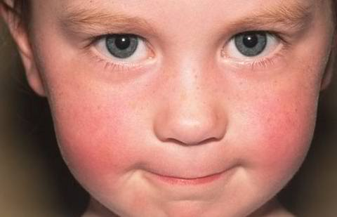
Case Study
Suzie, a 5-year-old girl, is sent to the nurse’s office for this facial rash. Suzie is afebrile in the office and has no complaints. After speaking with mom, you learn that Suzie had low -grade fevers and complained of a sore throat and body aches a few days ago. No one else in the family is ill, no known exposures, no family pets, child is UTD on her immunizations.

Slide 18
What is this rash? A) Systemic Lupus Erythematosus B) Measles C) Roseola D) Erythema Infectiosum

Slide 19
Fifth Disease (Erythema Infectiosum)
Caused by human parvovirus B19
Usually affects children between 4 and 10 years of age, more common in spring
Transmission is via respiratory droplets. Incubation period is 4 to 14 days
Low grade fevers, malaise, myalgia, headache, and sore throat often precede the rash
Rash appears first on the face—often present with a “slapped cheek” appearance
1 to 4 days after the facial rash appears, the rash spreads to the trunk & extremities.
The rash develops a characteristic lacy, reticular pattern as it moves down the body
Sunlight, physical activity, and hot baths can often exacerbate the rash

Slide 20
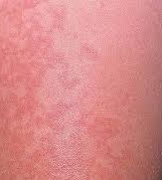
Fifth Disease (Erythema Infectiosum)
Treatment:
Supportive care---No specific treatment is indicated. Resolves over several weeks
Children with characteristic rash can return to school or daycare because they are no longer contagious
Notify any pregnant women they may have had contact with when they were contagious.
** Susceptible pregnant women who become infected during the first half of their pregnancy may transmit the infection to the developing fetus, resulting in fetal anemia or fetal death
Notes:
Clearance of viremia correlates with appearance of the rash, therefore patients who have the skin eruption are no longer considered contagious

Slide 21
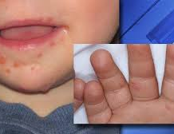
Case Study
6 -year-old Mary is sent down to the nurse’s office because she feels warm and the teacher has noticed a vesicular rash around her mouth and on her hands. Mary is complaining that her throat hurts. Her temperature in your office is 101.

Slide 22
What is this rash? A) Hand, Foot, & Mouth B) Herpangina C) Herpes Zoster D) Herpes Simplex

Slide 23
Hand, Foot, & Mouth Disease (HFM)
Caused by enteroviral or coxsackie viruses
Occurs most often in late summer or early fall
Incubation period is 4 to 6 days
Signs & Symptoms:
Fevers
Vesicular eruptions in oropharynx (ulcerations most commonly found on buccal mucosa, tongue, soft palate, uvula, and tonsillar pillars)
Painful vesicular lesions on hands, feet, buttocks, elbows, knees and perineum
Notes:
Caused by enteroviral or coxsackie viruses
Occurs most often in late summer or early fall
Incubation period is 4 to 6 days
Signs and symptoms: fevers, vesicular eruptions in the oropharynx; ulcerations most commonly found on buccal mucosa, tongue, soft palate, uvula, and tonsillar pillars, painful vesicular lesions on hands, feet, buttocks, elbows, knees, and perineum

Slide 24
Question
What teaching should you provide parents regarding HFM?
A) Tell parents that HFM is an illness that only young children can catch and that they will not come down with the disease.
B) Instruct parents to make an appointment for their daughter because she will need to be placed on oral antibiotics.
C) Tell parents that nail shedding may occur for several months following HFM.
D) Tell parents that HFM is not contagious and their child may stay at school.

Slide 25
Hand, Foot, & Mouth Teaching
Answer: C—Nail shedding may occur several months following HFM
HFM occurs most often in infants and children younger than 5 years of age; however older children and adults may also become infected. One may come down with the disease again because HFM is caused by several different viruses
Supportive measures—Tylenol/Motrin, soft foods, encourage fluids, avoid spicy or acidic foods, Maalox/Benadryl. Most people recover in 7-10 days. Assess for dehydration!
Highly Contagious!! Spread by close contact (hugging, kissing, sharing cups/utensils), coughing/sneezing, contact with poop (changing diapers), contact with blister fluid, touching objects or surfaces that have virus on them
May return to school when fever free
Notes:
Older children and adults can also get HFMD. It is most common in infant and children younger than 5 years of age
Not serious and nearly all people recover in 7-10 days without medical treatment.
Rarely an infected person can develop viral meningitis and may need to be hospitalized for a few days. Other even more rare complications can include polio-like paralysis, or encephalitis
People can get it again because HFMD is caused by several different viruses
HFMD is spread from an infected person to others from:
Close contact (kissing, hugging, sharing cups or utensils)
Coughing and sneezing
Contact with poop
Contact with blister fluid
Touching objects or surface that have the virus on them

Slide 26
Case Study
9-year-old Jack is sent to the nurse’s office for the following facial rash. After contacting dad, you learn that the rash initially resembled tiny blisters. The blisters recently broke open, leaving red, moist sores that occasionally ooze. Over the past day, Dad reports that the red sores developed a honey-colored yellow crusting. Dad states that the rash originally started around his son’s mouth and nose, and recently spread to his arms and legs.

Slide 27
What is this rash? A) Scabies B) Hand, Foot, & Mouth C) Herpes Simplex D) Impetigo

Slide 28
Impetigo
Most commonly caused by group A streptococcus, Staphylococcus aureus, or MRSA
Occurs most often in children between 2 and 6 years of age
Clinical Findings-
Non-bullous: honey-crusted lesions on erythematous base; usually on the face & extremities
Bullous: superficial bulla containing serous fluid/pus that rupture leaving an erythematous erosion
Management- topical Bactroban if lesions not widespread. Oral antibiotics for bullous impetigo or widespread involvement. Contagious until treated for 24 hours.
Teaching - cleanliness, handwashing, and spread of disease. Very contagious. Don’t pop or pick at the bullous blisters. Debride crust before application of topical antibiotic.
Notes:
In the US, Staph Aureus is the primary etiologic agent.
Incubation time is from 1-3 days if impetigo is caused by strep, 4 to 10 days with staph-caused impetigo
2 types of impetigo:
Non-bullous (crusted): more common, initial lesion is superficial vesicles that ruptures easily; exudate dries to form a honey-colored crust.
Bullous: a superficial bulla containing serous fluid or pus forms and then ruptures to for a round, erythematous erosion
It is highly contagious; easily spread from person to person by direct contact with lesions or indirectly touching items (clothing, sheets, or toys) that have been used by infected individuals
Impetigo often spreads to other parts of the body
--wash hands frequently
-keep clothing and bedding clean
Do not share towels/personal care items
The National Federation of State High School Associations (NFHS) says that children can return to practice and competition 72 hours after onset of treatment, provided there is no drainage from the lesions. Recommend covering lesions with bio-occlusive dressing

Slide 29
Case Study
8-year-old Chloe is sent to the nurse’s office because she keeps scratching at her arms and legs. You notice several maculopapular lesions on Chloe’s arms and legs. The lesions look like they have a central hemorrhagic punctum and appear to be in small linear groups. Chloe states that the lesions are very itchy. She does not have a fever and denies any other symptoms. Immunizations are UTD
Notes:
Incubation 1-2 weeks
Starts with a sudden, high fevers. Some may have a sore throat, runny nose or cough along with or preceding the fevers. Fevers generally last 3-5 days
Once the fever subsides, a rash develops—generally flat; usually starts on the chest, back and abdomen and then spreads to the neck and arms
Caused by Herpes Virus 6 or 7;
10-15% of children have a generalized tonic-clonic seizure associated with fever

Slide 30
What is this rash? A) Scabies B) Chicken Pox C) Bed Bugs D) Hives

Slide 31
Bed Bugs
Often in a breakfast-lunch-dinner alignment
Most common clinical presentation is a 2-5 mm pruritic maculopapular lesion with a central hemorrhagic punctum located in areas typically uncovered when sleeping
Most common sites are arms and legs; however, can occur anywhere
Caused by bite of C.lectularius
Blister-capped papules and intense itching occur within 48 hours after a bite.
Other symptoms include pruritis, papules, nodules, and bullous eruptions
Notes:
-appear as 3 or 4 bites forming a curve or line, referred to as the breakfast-lunch-dinner alignment
In case of numerous bites, it is possible for individual to have systemic symptoms, such as hives or fevers. Allergens from the bugs can also cause wheezing sometimes in individuals with asthma
-not all bites result in pruritis and an individual may have multiple bites before skin reactions occur

Slide 32
Treatment for Bed Bugs
Most reactions spontaneously resolve within 3-10 days
May treat irritations due to the bite with topical steroid and oral antihistamines
Encourage good handwashing and hygiene to prevent secondary infections
Eradication of infestation
Vacuum all rugs, floors, furniture, bed frames, and any cracks or crevices in home
Place mattress and box springs in encasements designed to protect against bed bugs for 1 year
Wash anything that touches the floor, clothes, bed sheets, blankets, and bedspreads in water with temperature > 120 degrees Fahrenheit
If items can not be laundered, place in plastic bad and put outdoors in a hot sunny location or inside a closed vehicle for at least 1 day
Professional eradication is most efficient and safest option to verify and treat infestations
Notes:
-once encasement is on the mattress, all bed bugs inside will be entombed and die.

Slide 33
Prevention of Bed Bugs
SLEEP Acronym
Survey surfaces for signs of infestation
Lift & look for all bed bug hiding spots, including underneath mattress, bed frame, headboard, and furniture.
Elevate luggage on luggage rack away from the bed and wall
Examine luggage carefully while repacking and when returning home
Place all clothing packed in luggage in the dryer for at least 15 minutes at the highest setting immediately after returning home
Notes:
-Signs of infestation ----tiny, rust-colored spots on bed sheets, mattress tags and seams, and bed skirts
-Typically bed bugs come out at night to feed, but during the day they are most likely within 1.5 meter radius of the bed
-bed bugs can hide behind headboards, artwork, picture frames, and electrical outlet
-always keep luggage away from the bed and store it in a closet or other area, far away from bedroom
Bed bugs need to bite every 3-5 days to grow and reproduce, however they can live for a year without feeding, therefore they can be very resilient pests that can be difficult to eradicate
Not all individuals react to bites from bed bugs, therefore be aware that family members that share the same bed may not have a reaction to bed bugs bites
Beg bugs travel as hitch hikers therefore recently purchased second hand furniture is often the culprit
They are small and difficult to see—may need to use a magnifying glass to see eggs, nymphs, and fecal material left behind

Slide 34
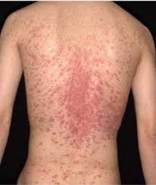
Case Study
10-year-old Sam is sent to the office for the following rash. Sam reports that the rash originally appeared on his neck and was a single red patch with central clearing and a scaly border as shown on the upper left picture. The rash became itchy today and that is when he noticed it had spread. He now has several smaller, oval plaques with a scaly border on his back. Sam is afebrile in the office. You call mom and she denies any new foods, lotions, detergents, soaps, or exposures. Denies any current URI symptoms.

Slide 35
What is this rash? A) Pityriasis Rosea B) Poison Ivy C) Tinea Corporis D) Tinea Versicolor

Slide 36
Pityriasis Rosea
Starts with a single salmon-colored patch (herald patch) that is oval in shape and has a slightly raised or rough texture. The patch usually is found on the torso and ranges in size from 2 to 10 cm.
One-two weeks later, several smaller, scaly plaques form on the chest or back, often in the shape of a Christmas tree
Cause is unknown (most likely viral cause, possibly some form of herpes) Not contagious and generally does not scar; usually clears up in 4-8 weeks
Treatment: No therapy required; rash may be pruritic—OTC calamine or topical steroids, along with oral antihistamines may help pruritus, lukewarm showers or soaking in oatmeal baths, judicious sun exposure may decrease pruritus and hasten resolution

Slide 37
Varicella (Chicken Pox)
Caused by varicella zoster virus
Highly contagious—transmitted by person- to-person contact, airborne
Incubation is typically 10-21 days
Occurs usually during the winter & spring
Clinical manifestations: low grade fever, malaise, anorexia, vesicular exanthem that usually begins on trunk & spreads centrifugally
Pruritus is common, and sometimes severe
Contagious from 1-2 days before onset of rash until all lesions have crusted
Notes:
Lesions may appear in crops, and may first appear as macules, which quickly develop a surface vesicle on an erythematous base----dew drop on a rose petal. These lesions usually crust within hours to days and then begin to gradually heal
Rash spread centrifugally so fresh vesicles may be seen on the extremities, with older crusted lesions on the trunk

Slide 38
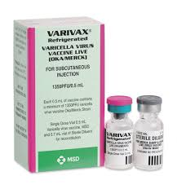
Treatment
Treatment: Supportive
Tylenol for fever (NO ASPIRIN)
Calamine lotion
Antihistamines
Keep fingernails short, frequent bathing
Acyclovir—must be started within 24 hours
Prevention: Immunization with Varivax
Children with uncomplicated varicella may return to school/daycare when the rash has crusted over, or in immunized people without crusts, when no new lesions have appeared within a 24-hour-period
Notes:
Treatment: Aimed at reducing itching and preventing secondary skin infections
For healthy children ≤12 years, varicella is typically self-limited and we do not routinely offer antiviral therapy. The management of neonatal varicella is discussed elsewhere. (See "Varicella-zoster infection in the newborn".)
●For individuals who present with, or are at high risk for complications (eg, unvaccinated adolescents, adults, pregnant women, immunocompromised hosts), we administer antiviral therapy to reduce the severity of symptoms and/or reduce the risk of complications
Treatment with ibuprofen is controversial because it has been associated with life-threatening streptococcal skin infections
Acyclovir not recommended in routine use of otherwise healthy children but is indicated for those at risk of serious disease (older than 12 years, those with chronic cutaneous or pulmonary disease, those receiving long term aspirin or salicylate containing compound therapy or those receiving short, intermittent, or aerosolized steroid therapy
We suggest oral antiviral therapy for immunocompetent children and adolescents who are at increased risk of developing complications from varicella (eg, pneumonia, skin infection) [14-16], since antiviral therapy may theoretically reduce the risk of complications in these patients and is generally well tolerated. These individuals include:
●Unvaccinated adolescents (ie, children ≥13 years of age) since these patients are more likely to have severe disease compared with younger children [17].
●Secondary cases in household contacts since these cases are usually more severe than primary cases [18].
●Patients with a history of chronic cutaneous or pulmonary disorders since secondary bacterial infections may have severe consequences.
●Children taking intermittent oral or inhaled steroid therapy. The risk is greatest when corticosteroids are administered during the incubation period.
●Individuals taking chronic salicylates. These individuals are at risk of developing Reye syndrome. (See "Acute toxic-metabolic encephalopathy in children", section on 'Reye syndrome'.)

Slide 39
Differences Between Chickenpox & Shingles
Chickenpox (Varicella)
Shingles (Herpes Zoster)
Primary infection with varicella-zoster virus
Systemic: Usually widespread rash over trunk, face, & extremities
Usually children
Infectious from 1-2 days before the rash appears until after the rash blisters have dried up
Symptoms: mild fever, loss of appetite, headache, fatigue; itchy rash that becomes blisters
Varicella zoster-virus establishes latent infection in dorsal root ganglia and cranial nerves
Secondary infection from reactivation of latent varicella-zoster virus
Localized: Rash occurs in the area the affected nerve supplies, typically back/chest or face
Usually adults aged 50 years or older
Infectious once the rash becomes blisters until after the rash blisters have dried up
Symptoms: Tingling, burning, numbness where rash appears; mild fever, fatigue; unilateral, localized rash that becomes blisters, nerve pain
Contact with liquid from blisters may cause chicken pox

Slide 40
Shingles (Herpes Zoster)
Treatment:
Antiviral Medications: Acyclovir
Tylenol/Ibuprofen for pain
Keep affected area clean, dry, and exposed to air as much as possible
Prevention: Shingrix or Zostavax—Shingrix reduces chances of getting shingles by 90%
Notes:
Is Shingles Contagious?
Yes and no. It is not possible to "catch" shingles from someone who has the rash. But if you have never had chickenpox or gotten the chickenpox vaccine, it is possible to "catch" the virus and then get sick with chickenpox. Shingles and chickenpox are caused by the same virus.
You probably will not catch the virus (or get chickenpox) if you:
●Had chickenpox or shingles in the past
●Had the chickenpox vaccine
●Were born in the United States before 1980 (most people born before 1980 have had chickenpox even if they don't remember it)
If you have never had chickenpox or the chickenpox vaccine, be careful around anyone with shingles. Do not touch their rash. If you do, you could get sick with chickenpox. In rare cases, people can even get chickenpox from just being near someone with shingles. This is most likely if the person with shingles cannot fight infections well.
●If you have never had chickenpox or the chickenpox vaccine, you can develop chickenpox after direct (skin to skin) contact with a shingles blister or by inhaling the varicella-zoster virus in the air. You should take precautions if you are near anyone with shingles. (See "Patient education: Chickenpox prevention and treatment (Beyond the Basics)".)
●If you have had chickenpox or the chickenpox vaccine, being near a person with shingles will not cause you to develop shingles
Exclusion of children with zoster whose lesions cannot be covered is based on similar criteria. Children who are excluded may return after the lesions have crusted. Lesions that are covered pose little risk to susceptible people, although transmission has been reported.
Care of Exposed People
Potential interventions for people without evidence of immunity exposed to a person with varicella or herpes zoster include: (1) varicella vaccine, administered ideally within 3 days but up to 5 days after exposure (followed by a second dose of vaccine at the age-appropriate interval after the first dose); (2) when indicated and available, VariZIG (or IGIV; see Unavailability of Varicella-Zoster Immune Globulin, p 876); or (3) if the child cannot be immunized and VariZIG is not indicated or is unavailable, preemptive oral acyclovir or valacyclovir starting day 7 after exposure. These options are discussed in detail below. When used, VariZIG should be administered as soon as possible following exposure, ideally within 96 hours for greatest effectiveness; limited data suggest benefit when administered up to 10 days after exposure. Preemptive oral acyclovir has only been studied in the normal host but sometimes is used in addition to VariZIG or IGIV in the immunocompromised host.
Contact with fluid from a shingles lesion can cause varicella (chickenpox) in an individual who has never had chickenpox or the varicella vaccine. Fever blisters (cold sores) are HSV1 infections around the mouth and lips. Lesions on exposed areas of skin that are not covered by clothing, uniform or equipment require the player to be withdrawn from any activity that may result in direct skin-to-skin contact with another participant. Covering infectious lesions with an occlusive dressing is not adequate, sufficient, or acceptable. Prior to returning to participation, primary outbreaks of shingles and cold sores require 10-14 days of oral antiviral medications, while recurrent outbreaks require 120 hours of treatment as a minimum treatment time. For a student to be considered “non-contagious,” all lesions must be scabbed over with no oozing or discharge, no new lesions should have occurred in the preceding 72 hours, and no systemic symptoms (fever, malaise).

Slide 41
Case Study
8-year-old Laurie is sent to the nurse’s office for a flesh-colored, raised rash on her abdomen. Her teacher noticed the rash today because Laurie kept scratching at it. After talking with Laurie’s mom, you learn that mom first noticed a few bumps on her daughter’s abdomen two-three months ago. Mom reports that she believes her daughter has developed more bumps recently. Mom reports that occasionally the bumps are itchy but most of the time they do not bother her daughter. Family has no pets, no one else in the family has a similar rash, and patient has been free of illness.

Slide 42
What is this rash? A) Folliculitis B) Skin Tags C) Flat Warts D) Molluscum Contagiosum

Slide 43
Molluscum Contagiosum
Caused by Poxvirus
Common in school aged children
Spreads by direct skin-to-skin contact, autoinoculation by scratching or touching a lesion, via fomites on bath towels/sponges, or through skin contact during participation in contact sports
Clinical Manifestations: usually asymptomatic, flesh-colored, dome-shaped papules with a central depression that can appear anywhere EXCEPT palms and soles.
Educate on the importance of PATIENCE. Will spontaneously resolve over several months or years without intervention. Treatment often requested by parents
Notes:
Umbilcated—have a central depression
Most common sites are trunk, axillae, antecubital and popliteal fossae, folds of extremities, eyelids, and genital region
Treatments: cantharidin (blister beetle extract), curettage, cryotherapy with liquid nitrogen

Slide 44
Case Study
10-year-old Matt is sent to the nurse’s office with the following rash. Matt reports that the rash does not hurt; however complains that it is mildly pruritic. The rash is not warm to the touch. Matt does not have a fever; however complains of fatigue and headache. Denies any recent changes in soaps, lotions, or detergents. He denies any recent travel; however does report that last week he was playing in a heavily wooded area.

Slide 45
What is this rash? A) Erythema Multiforme B) Cellulitis C) Lyme Disease D) Nummular Eczema

Slide 46
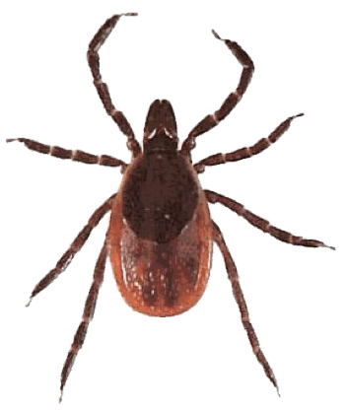
Lyme Disease
Transmitted by the tick Ixodes scapularis (black-legged tick or deer tick)
In 2019 for the first time in Nebraska, established populations (meeting CDC criteria) of this tick were identified in Douglas, Sarpy, and Saunders counties.
Early localized Lyme disease is manifested by a single erythema migrans lesion at the site of attachment of the tick
Erythema migrans lesions usually are flat and without scale; they may be pruritic or burning but are rarely painful.
Other symptoms associated with erythema migrans include fever, fatigue, headache, neck pain, arthralgia, and myalgia.
This Photo by Unknown Author is licensed under CC BY-SA
Notes:
However, even with these established populations, Nebraska is a low-prevalence state for Lyme disease
Most cases reported in the Northeast and upper Midwest
Erythema migrans is a rash that appears at the site of the tick bite, usually within 7 to 14 days after the bite (range 3 to 30 days
Erythema migrans begins as a red macule at the site of attachment of the tick
Untreated, the rash expands over the course of days to weeks to form a large, annular, erythematous lesion that is at least 5 cm and as many as 70 cm in diameter (median 15 cm).
The lesion is more likely to occur on the head or neck in younger children and on the extremities in older children
Localized erythema migrans may be accompanied by systemic findings, such as fever (24 percent), fatigue (58 percent), headache (42 percent), neck pain (26 percent), arthralgia (33 percent), or myalgia (16 percent) [6].

Slide 47
Early Disseminated & Late Disease
Early Disseminated Disease:
Occurs weeks to months after the tick bite
The clinical manifestations of early disseminated Lyme disease in children include multiple erythema migrans, cranial nerve palsy, meningitis , & carditis
Late Disease
Occurs months to years after the onset of infection
May not be preceded by history of early localized or disseminated Lyme Disease
Arthritis is leading symptom in US followed by neurologic manifestations
Knee most common joint affected
Notes:
If Lyme disease is not recognized or treated during the early localized stage, the spirochete may enter the bloodstream and disseminate to tissues throughout the body, potentially including the central nervous system (CNS) and the heart

Slide 48
Treatment of Lyme Disease
Oral doxycycline, amoxicillin, and cefuroxime are treatment for Early Lyme Disease and recommended if patient has erythema migrans
Treatment usually ranges from 10-21 days depending on antibiotic
Discuss Prevention
Checking for and removing ticks after outdoor activities
Bathing after outdoor activities where ticks are abundant
Placing dry clothes in dryers for a short time period after outdoor activities
Wear protective covering
Using tick repellent, such as DEET on skin, and permethrin on clothing
Notes:
Doxycycline is often used because it is effective in treating some of the potential coinfecting agents, including Anaplasma phagocytophilum and Borrelia miyamotoi. Of the oral agents commonly used to treat Lyme disease, doxycycline also has the best penetration into the central nervous system. The American Academy of Pediatrics supports the use of doxycycline for children <8 years of age if it is administered for ≤21 days
Approach to prophylaxis — We agree with the Infectious Diseases Society of America (IDSA) guidelines that recommend antibiotic prophylaxis only in patients who meet all of the following criteria (table 2) [10]:
●Attached tick identified as an adult or nymphal I. scapularis tick (deer tick).
●Tick is estimated to have been attached for ≥36 hours (by degree of engorgement or time of exposure).
●Prophylaxis is begun within 72 hours of tick removal.
●Local rate of infection of ticks with B. burgdorferi is ≥20 percent (these rates of infection have been shown to occur in parts of New England, parts of the mid-Atlantic States, and parts of Minnesota and Wisconsin).
●Doxycycline is not contraindicated. (See "Tetracyclines", section on 'Special populations' and "Tetracyclines", section on 'Adverse reactions'.)

Slide 49
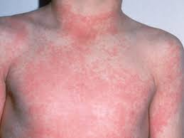
Case Study
7- year-old Matt is sent to the school nurse with complaints of a sore throat, headache, and stomachache. He has a fever of 102.2. You also notice a fine, rough-feeling rash on his neck, trunk, and under his arms.

Slide 50
What is this rash? A) Measles B) Scarlatina C) Viral Exanthem D) Urticaria

Slide 51
Scarlet Fever (Scarlatina)
Rash starts out looking like a bad sunburn; typically starts on neck and face, and then spreads to chest, back, and the rest of the body
Rash is red, raised, blanchable, feels rough like sandpaper. In body creases (underarms, elbows, groin), the rash forms red streaks
Usually accompanied by strawberry looking tongue, sore throat, fever, chills, headache, N/V, stomachache
Caused by Group A Strep; occurs most often in children ages 5 to 15 years; spread from person to person via respiratory droplets, incubation is usually 2-4 days
Treatment: Antibiotics: PCN, Keflex if PCN allergic, for 10 days; Tylenol/Motrin for fevers/sore throat; offer soft foods and push fluids; may return to daycare/school when afebrile and has been on antibiotic for 24 hours
Notes:
Group A beta hemolytic streptococci produce and erythrogenic toxin that causes scarlet fever; incubation can be from 12 hours to 7 days, most commonly is 2-4 days

Slide 52
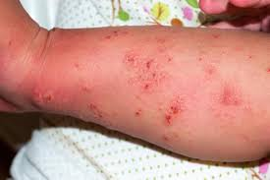
Case Study
A seventeen-year old male comes into your office with concerns of a rash that is extremely pruritic. He has had the rash for the the past 2 weeks and it seems to be worsening. He describes the rash as small, red raised bumps. The rash is located in the webs of his fingers, on his wrists, ankles, waist, and groin. The rash is extremely itching, especially at night. He has been applying brother’s topical steroid cream without any improvement or relief from itching. He reports that 6 weeks ago he went on a spring vacation with a group of friends to the beach. His “bunkmate” on vacation has a similar rash as well.

Slide 53
What is this rash? A) Eczema B) Psoriasis C) Herpes Simplex D) Scabies

Slide 54
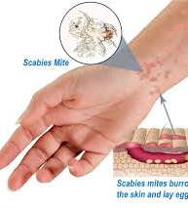
Scabies
Worldwide problem: affects all ages, races, and socioeconomic classes
Caused by mites that burrow into the epidermis of the skin & lay eggs
Incubation period is 4 to 6 weeks if the individual has not been exposed previously; those with prior exposure can have milder symptoms that occur within 1 to 4 days
Transmission: via direct skin-to-skin contact, acquisition from fomites is less common
Usually presents with a papular, erythematous rash
Common rash sites: inter-digital web spaces of hands and feet, wrists, elbows, axillae, and genital/groin region. Children younger than 2 years of age generally have a more widespread distribution that also includes face, neck, palms, and soles
Notes:
Ensure that treatment was applied correctly
Entire body, not just affected areas
Leave on for 8-14 hours before rinsing
Clothes and linens washed
Vacuum
Treat family and friends
Repeat treatment in 1 week

Slide 55
Scabies-Treatment
Permethrin (Elimite)
Drug of choice for children & infants > 2 months
Applied from neck to feet (head to feet in infants) and left on for 8 to 14 hours before rinsing
Often second treatment one week later is recommended
Mild to Moderate Steroids-No efficacy in treating the mite infection but can be helpful for the intense pruritus during and just after the scabies infections
Signs/Symptoms of scabies may persist for several weeks following treatment and may be treated with oral antihistamines as necessary
Prophylactic treatment of household members & other close contacts should be performed at the same time the patient is being initially treated
Notes:
Ensure that treatment was applied correctly
Entire body, not just affected areas—paying special attention to interdigital regions, skinfolds of wrist, elbow, and inguinal creases, and under nails
Leave on for 8-14 hours before rinsing
Clothes and linens washed
Vacuum
Treat family and friends
Repeat treatment in 1 week

Slide 56
Question
What information would you provide this patient & his family regarding things they should do to get rid of the infestation and prevent its spread?
A) Bedding and clothing worn next to the skin during the 3 days before the initiation of therapy should be laundered in a washer with hot water and dried using a hot cycle for at least 10 minutes.
B) Anything that cannot be washed should be removed from the patient & stored for several days, up to a week, to avoid re-infestation.
C) Furniture and carpets in the household of an infected person should be vacuumed.
D) He may return to school/work after treatment has been completed
E) All of the above

Slide 57
Triaging Rashes
Important things to assess
Appear or act ill?
Is there lip, tongue or throat swelling?
Is the child breathing comfortably?
Does the rash blanch?
Other important questions to ask
Fever
Medications
Any change in soap, lotions or detergents
Any new clothes or bed linens not washed prior to using
New foods
Bites or stings
Travel or camping
Notes:
When deciding whether your child’s rash can wait for the pediatrician, or needs to be seen immediately, remember the important questions: Does he appear ill (looking past that awful rash!). Is there lip, tongue, or throat swelling? Is she not breathing comfortably? Are there tiny red freckles that don’t blanch when pressed? If yes, proceed to the nearest Emergency Department.

Slide 58
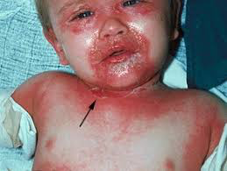
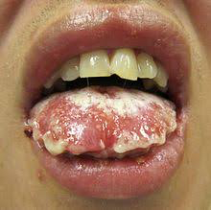
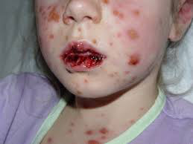
RED FLAGS
Blistering, Skin Sloughing or Mucosal Involvement
Notes:
The following findings are of particular concern & these children need to be evaluated as soon as possible
The picture on the left is of staphylococcal scalded skin syndrome; the middle and picture on right are of Stevens Johnson Syndrome. These 2 rashes are a medical emergency

Slide 59
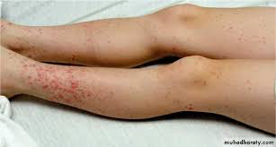
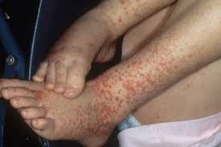
RED FLAGS
Diarrhea and/or Abdominal Pain
Notes:
Bloody diarrhea with pallor and petechiae raise the concern about the possibility of hemolytic uremic syndrome or HSP (Henoch-Scholein Purpura)

Slide 60
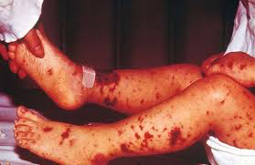
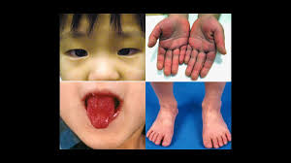
RED FLAGS
Fever and inconsolability OR fever and petechiae/purpura
Notes:
Any child with fever and petechiae or purpura needs to be evaluated carefully for meningitis. Fever for >5 days with evidence of mucosal inflammation and rash should be evaluated for Kawasaki Disease

Slide 61
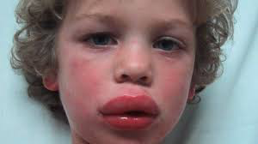
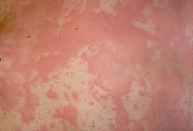
RED FLAGS
Urticaria with Respiratory Distress

Slide 62
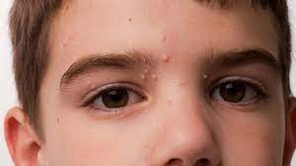
Should they Stay or Should they Go?

Slide 63
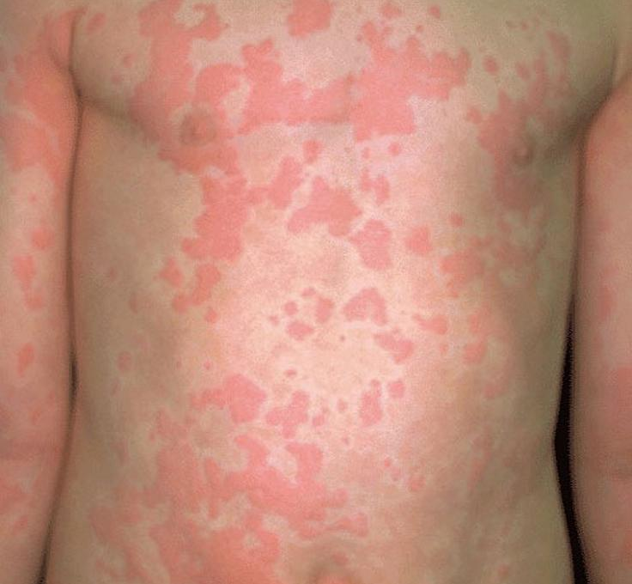
Should they Stay or Should they Go?

Slide 64
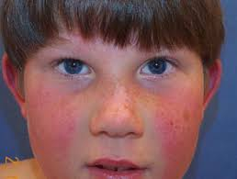
Should they Stay or Should they Go?

Slide 65
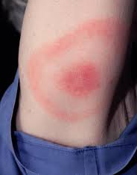
Should they Stay or Should they Go?

Slide 66
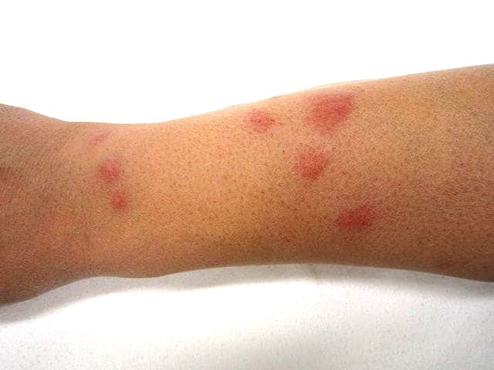
Should they Stay or Should they Go?

Slide 67
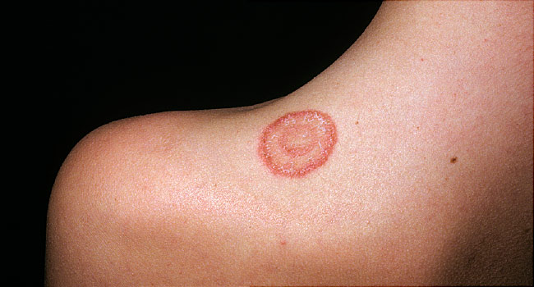
Should they Stay or Should they Go?

Slide 68
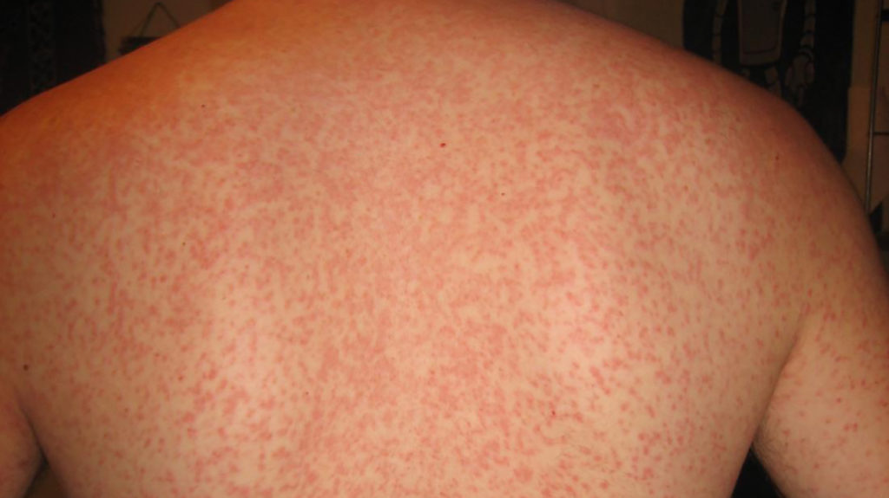
Should they Stay or Should they Go?

Slide 69
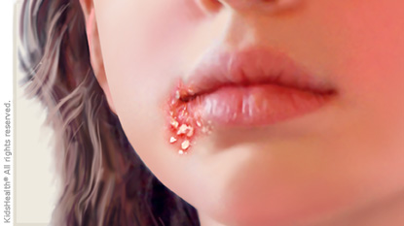
Should they Stay or Should they Go?

Slide 70
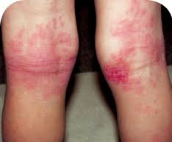
Should they Stay or Should they Go?

Slide 71
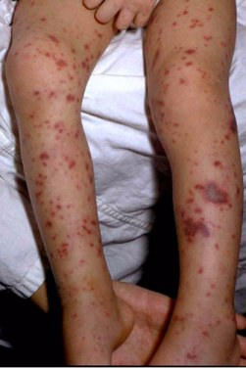
Should they Stay or Should they Go?

Slide 72
Questions?

