Slide 1
Blood Disorders & Adrenal Insufficiency: What You Need to Know
Dr. Chittalsinh Raulji, Hematology/Oncology
Dr. Monina Cabrera, Endocrinology
Children's Hospital & Medical Center
Wednesday, March 9, 3-4 PM CST

Slide 2
Blood Disorders
Dr. Chittalsinh Raulji, Hematology/Oncology

Slide 3
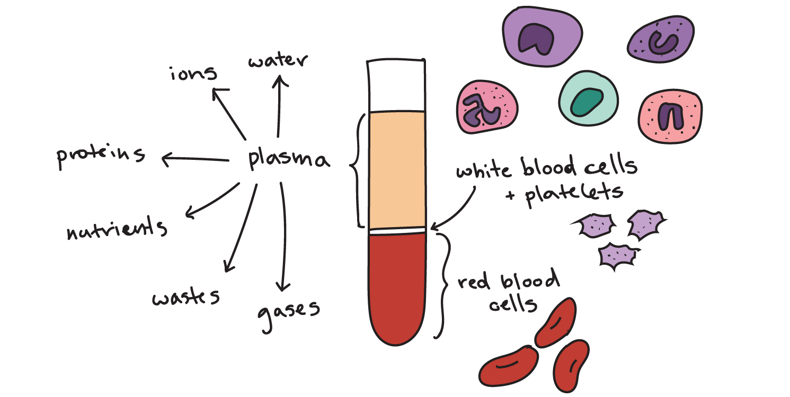
Blood Composition

Slide 4
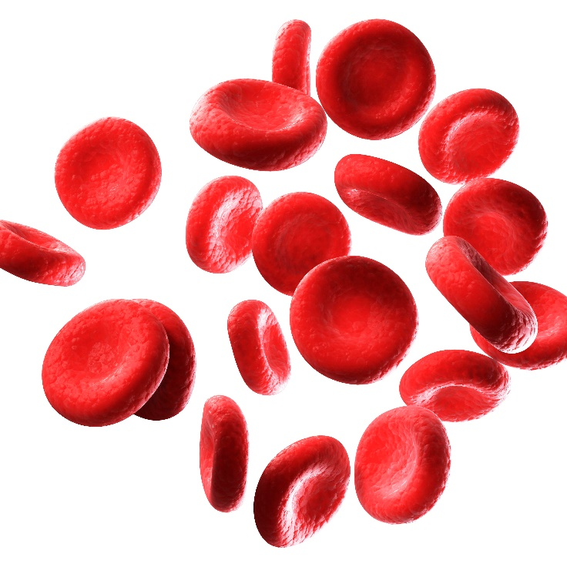
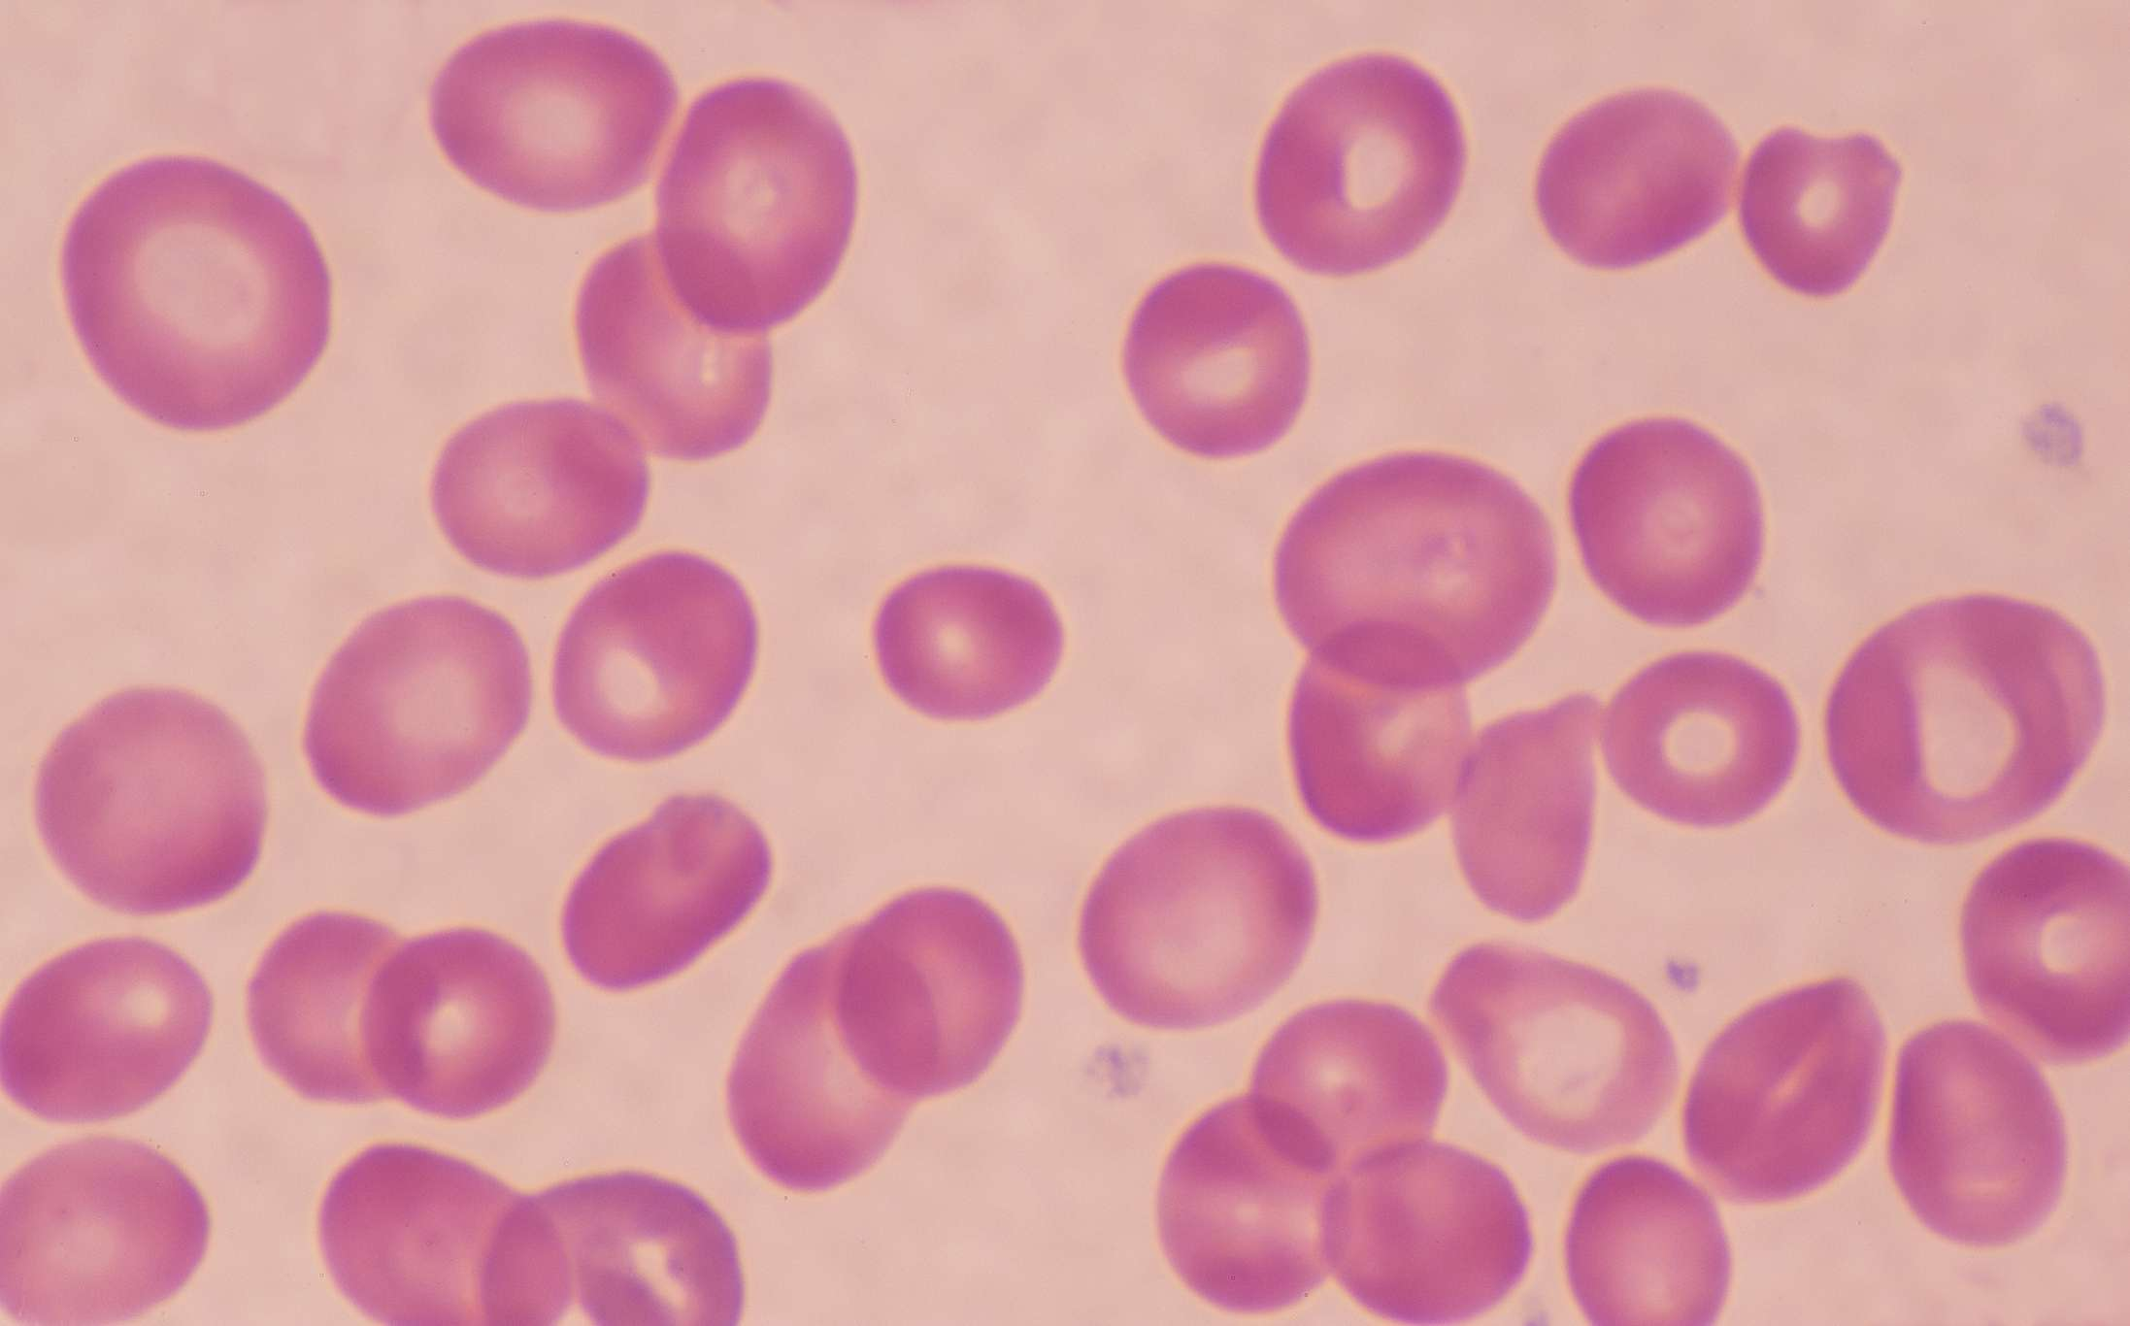
Red Blood Cell – Hemoglobin
ANEMIA

Slide 5
Most Common Anemias in School Aged Children

Slide 6
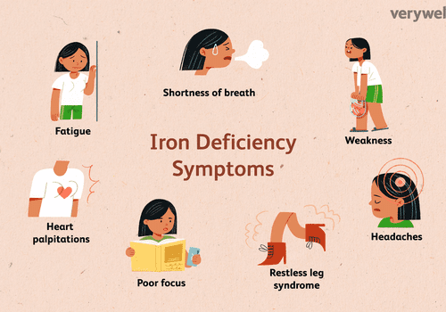

Slide 9
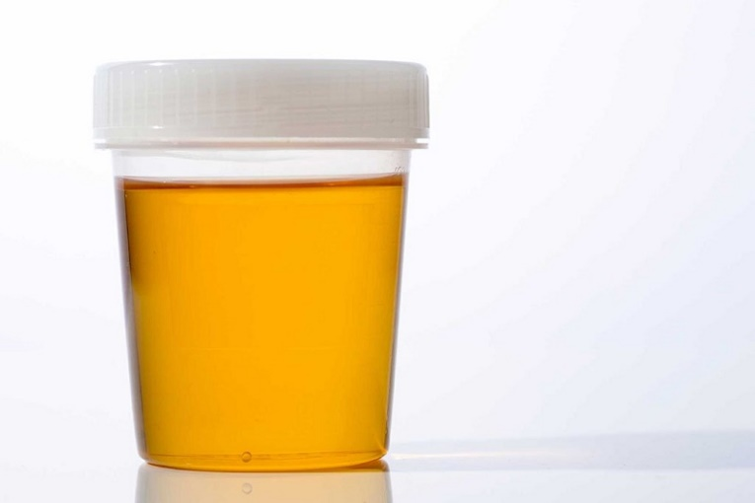
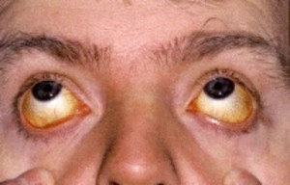
Hemolytic Anemia:
Hereditary Spherocytosis
Sickle Cell Disease
G6PD Deficiency

Slide 10
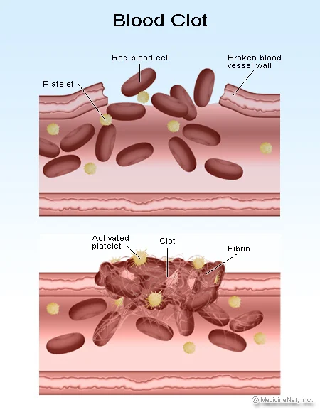
Platelets

Slide 11
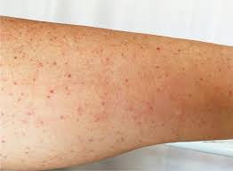
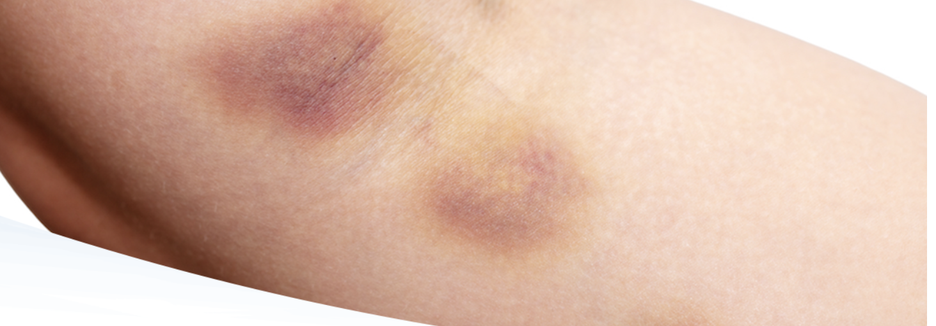
Immune Thrombocytopenic Purpura (ITP)

Slide 13
Treatment
Acute
IVIG
Steroids
Chronic
Immune-suppression
Bone Marrow stimulation

Slide 14
Platelets Higher than 100K are ALWAYS safe
Platelet Count < 75000
AVOID
Hockey
Boxing
Diving
Hang-glide
Football
Rugby
Lacrosse
Wrestle
Platelet Count >30 to 50 K
Usually OK to Play
Baseball (Wear helmet – no catcher)
Basketball
Swimming
Gymnastics
Skating
Biking
Running
Skiing
Volleyball

Slide 15
Leukemia
High WBC count and immunosuppression – Fever
Anemia – Pale, tired
Low platelets – Bruising.

Slide 16
During Treatment of Leukemia
For Acute lymphoblastic Leukemia the patient can be taking chemotherapy and be in school
These kids are immunocompromised
Any fever >100.4 need to be evaluated and they need IV antibiotics.

Slide 17
Adrenal Insufficiency
Dr. Monina Cabrera, Endocrinology

Slide 18
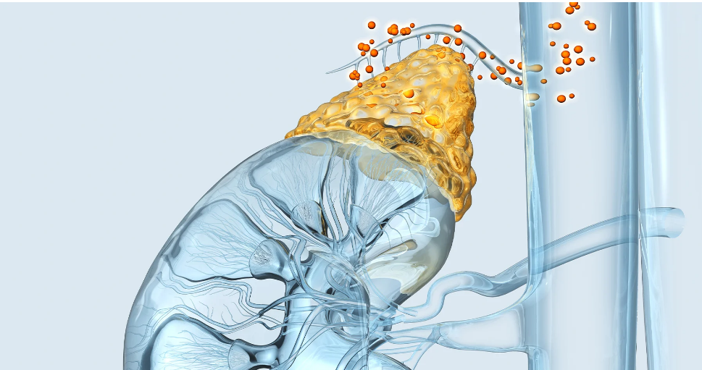
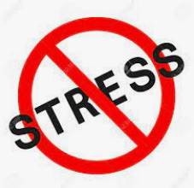
Adrenal Insufficiency

Slide 19
1. General information about adrenal insufficiency
2. Symptoms of adrenal crisis
3. Types of medications used for treating adrenal
insufficiency
4. Stress dosing

Slide 20
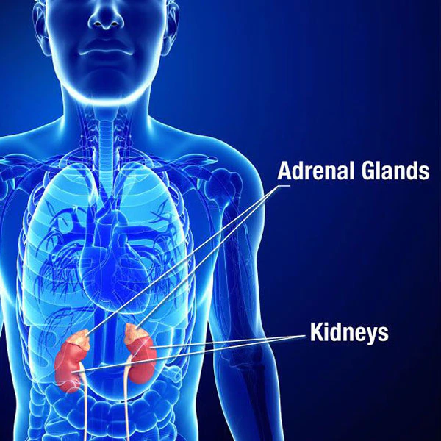
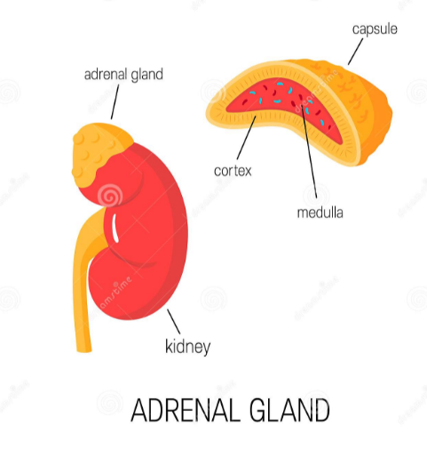
Adrenal glands

Slide 21
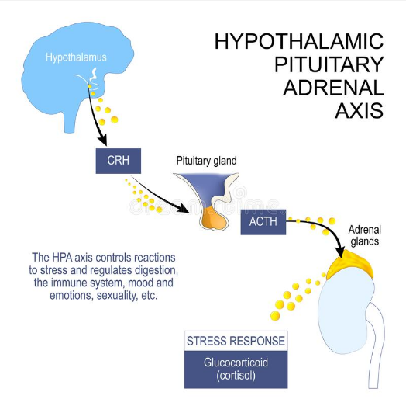
Regulation of adrenal gland
Stress
Infection
Dehydration
Trauma,
Severe pain
Surgery

Slide 22
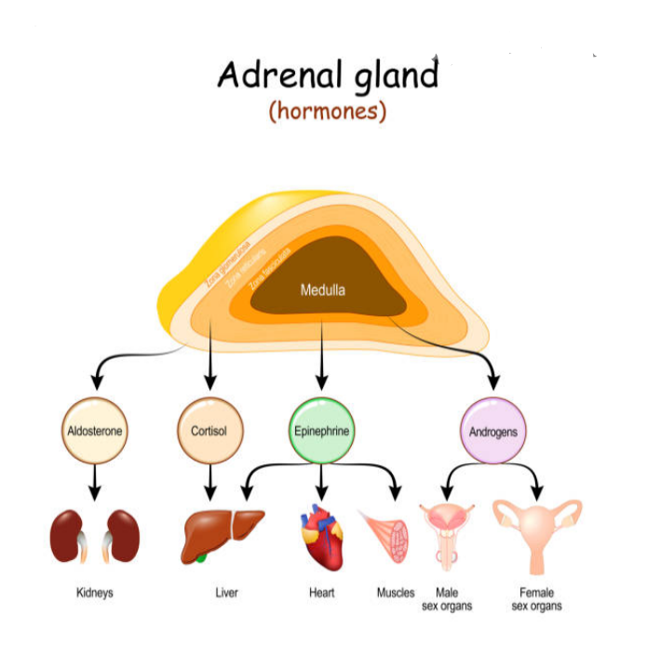
Adrenal hormones

Slide 23
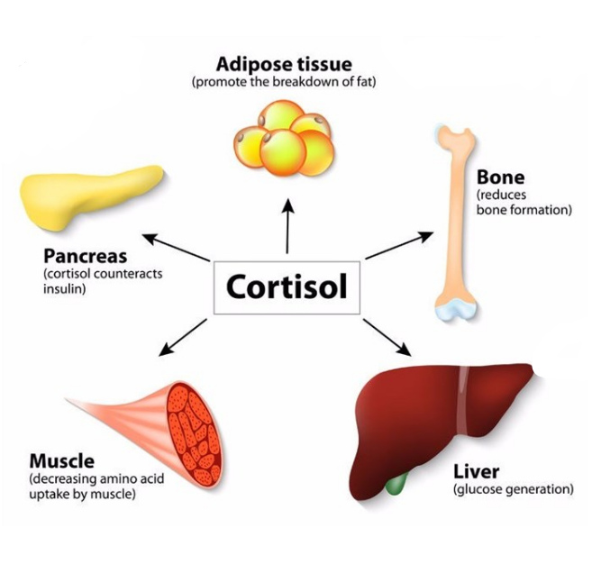
Cortisol
Cortisol
“Stress hormone”
Controls blood pressure
Controls blood glucose
Reduces inflammation
Controls metabolism

Slide 24
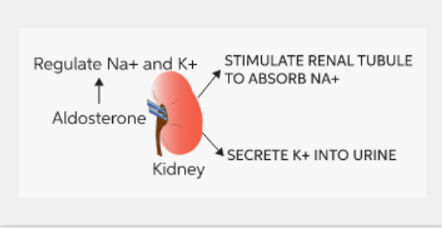
Aldosterone
Aldosterone
Controls blood pressure
Controls blood volume
Electrolyte (Na, K) balance

Slide 25
Adrenal insufficiency
Lack of adrenal hormones
Different types:
Primary
Adrenal glands are not working
Aka “Addison’s disease”
Secondary
Pituitary gland is not working
ACTH deficiency
Tertiary
Hypothalamus is not working
Steroid induced adrenal insufficiency

Slide 26
Adrenal insufficiency

Slide 27
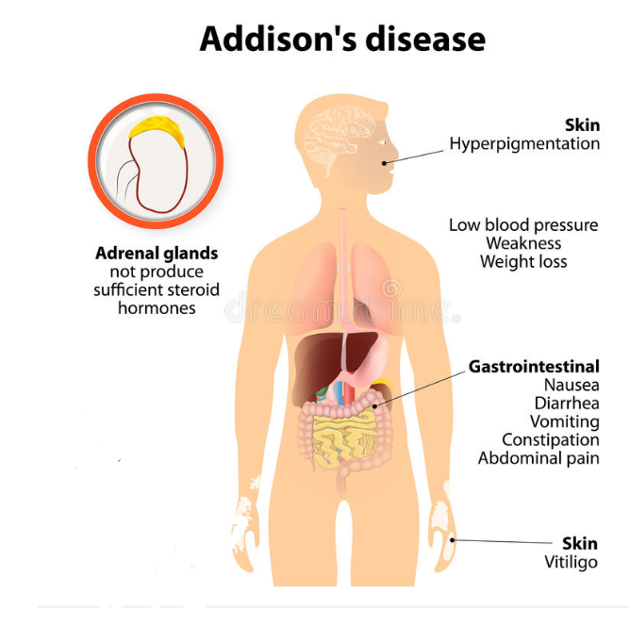
Adrenal insufficiency - symptoms
Most common: (chronic)
Chronic fatigue
Muscle weakness
Loss of appetite
Weight loss
Abdominal pain

Slide 28
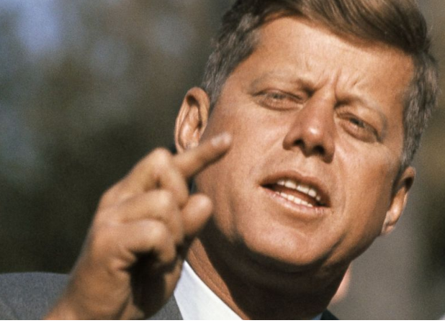
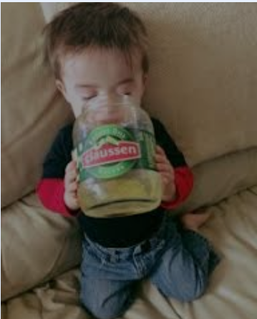
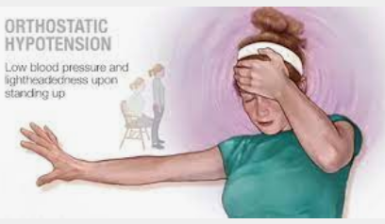
Adrenal insufficiency - symptoms
Other symptoms:
Nausea
Vomiting
Diarrhea
Postural hypotension
Irritability and Depression
Joint pain
Salt craving
Hypoglycemia
Irregular menses
Lack of interest in sex

Slide 29
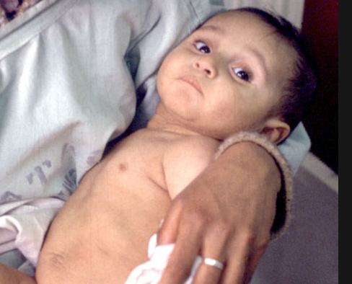
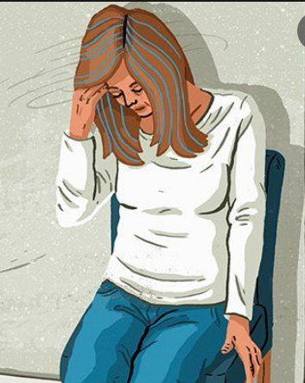
Adrenal Crisis
Most serious complication of adrenal insufficiency
Acute adrenal failure
• Severe vomiting/diarrhea
• Severe dehydration
• Orthostatic hypotension
• Tachycardia
• Loss of consciousness

Slide 30
Adrenal Crisis

Slide 31
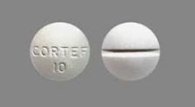
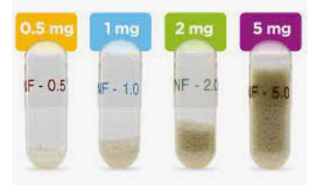
Adrenal insufficiency - treatment
Cortisol / Steroid replacement
Hydrocortisone, Prednisone, Dexamethasone
Fludrocortisone
“Stress dose”
Extra dose of steroid during times of extreme physical stress
2x-3x daily oral replacement dose

Slide 32
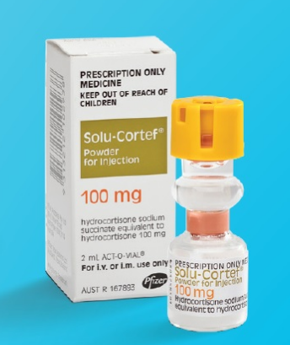
Adrenal insufficiency - treatment
Emergency injection of Hydrocortisone (Solu-Cortef) may
be required in these situations:
Severe or persistent vomiting or diarrhea
Lethargy
Seizures
Unconsciousness

Slide 33
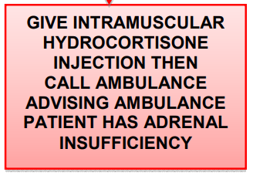
Adrenal insufficiency - treatment
Emergency injection of Hydrocortisone (Solu-Cortef)

Slide 34
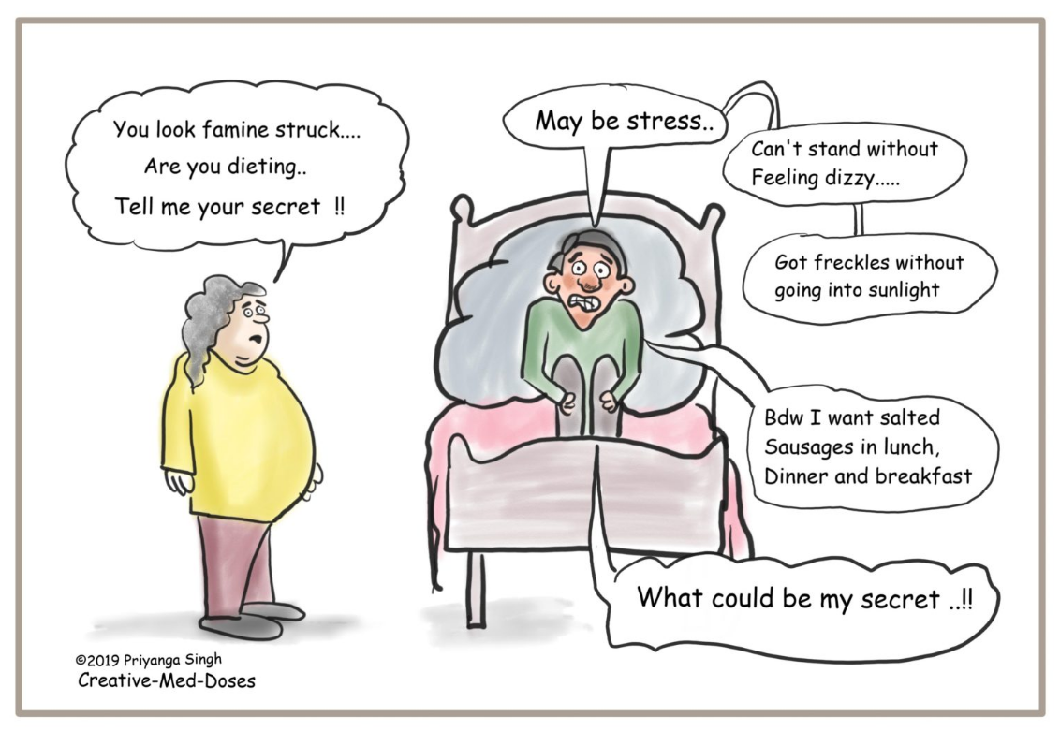
Thank you!

